Slide 1
SDGs in the Classroom: GIS Learning Resources and Data
2021 Madrid – “Sustainable Development Goals for all”
Dr. Michael Gould
Esri Inc. and Universitat Jaume I
mgould@esri.com

Slide 2
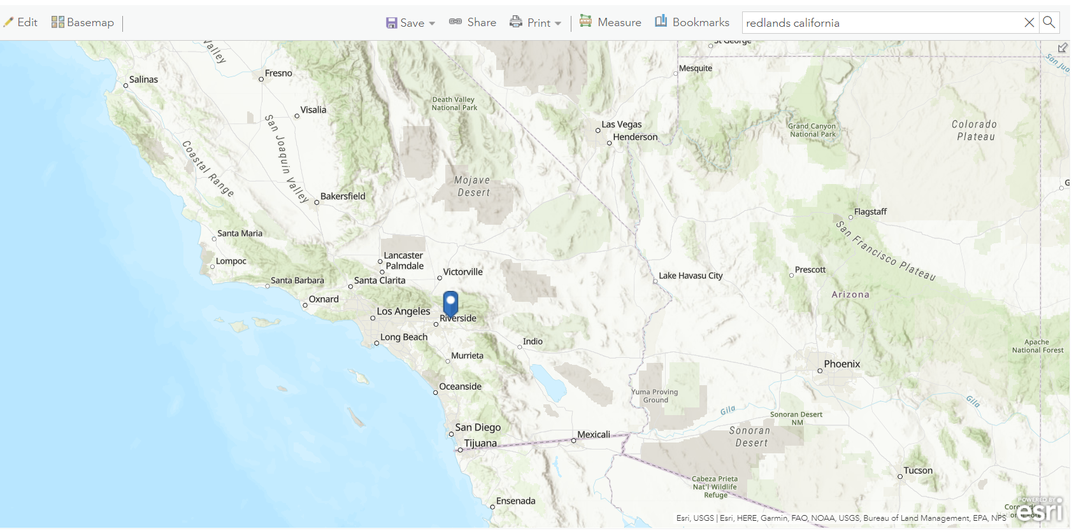
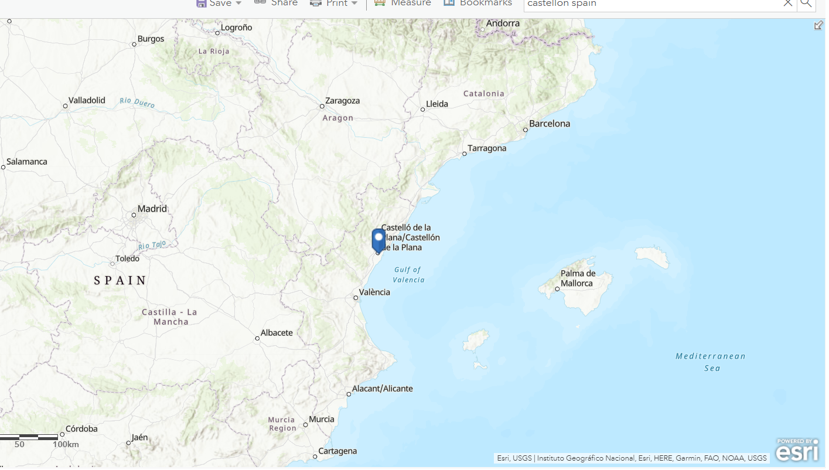

Slide 3
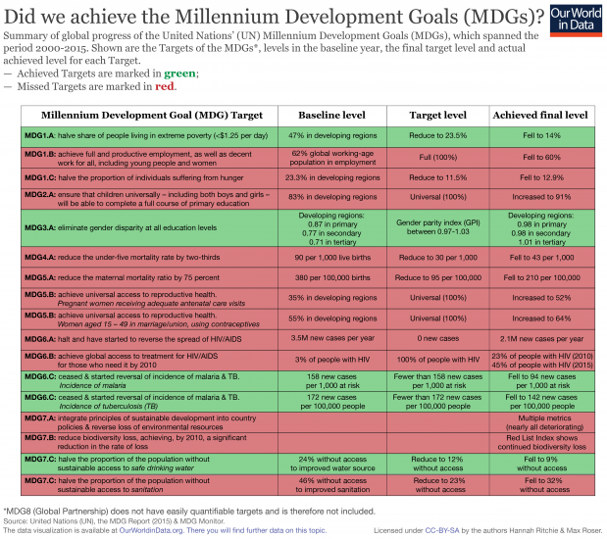
Millennium Development Goals (MDG) 2000-2015

Slide 4
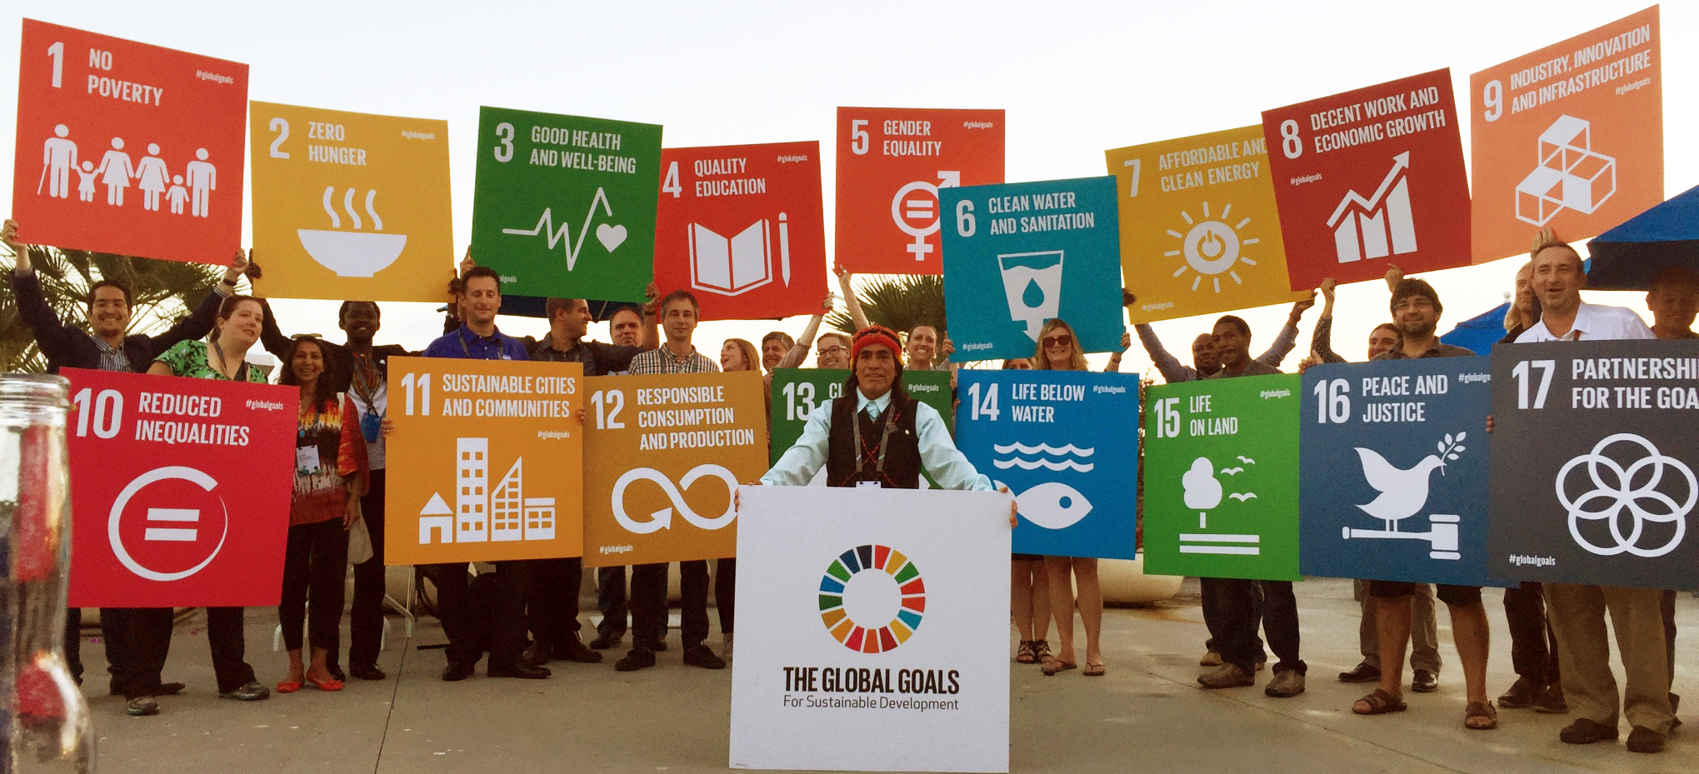
Sustainable Development Goals (SDG) 2012 (2015-2030)
Broader than the MDGs but then in 2017 made more “Actionable” by UN, adding Targets and Indicators.

Slide 5
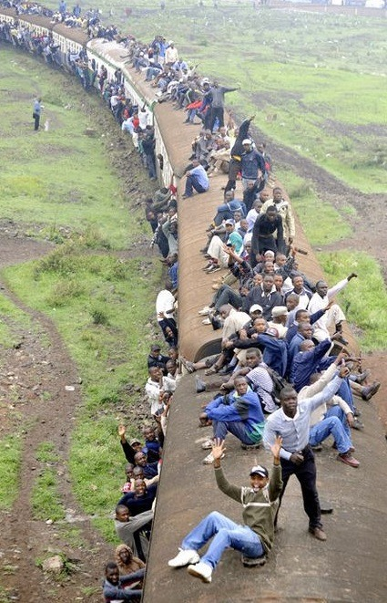
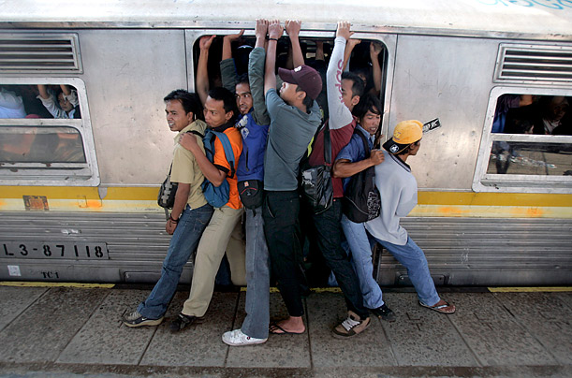
Everybody now on-board…
http://content.time.com/time/today-in-pictures/0,31511,1988651,00.html
https://silviapatriciabalaguer.tumblr.com/post/621738653828399105

Slide 6
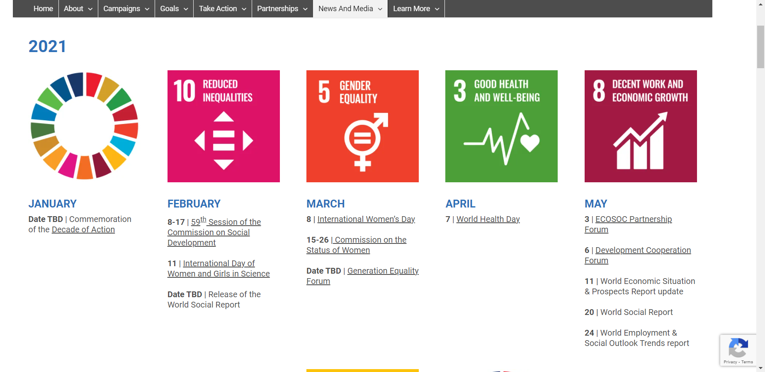
Almost Daily SDG Events

Slide 7
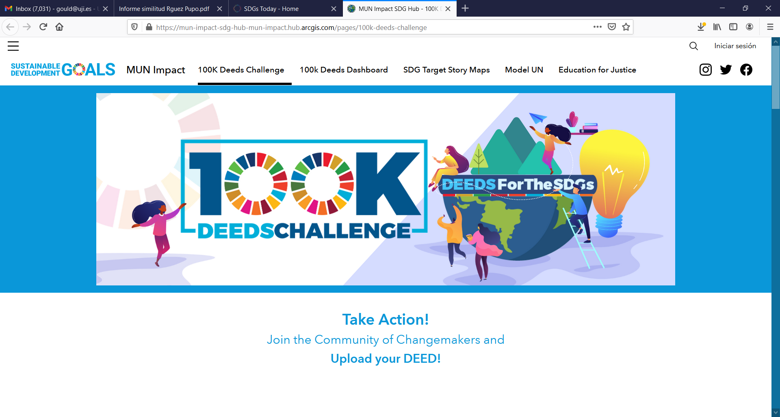
Contests, Challenges
https://mun-impact-sdg-hub-mun-impact.hub.arcgis.com/pages/100k-deeds-challenge

Slide 8
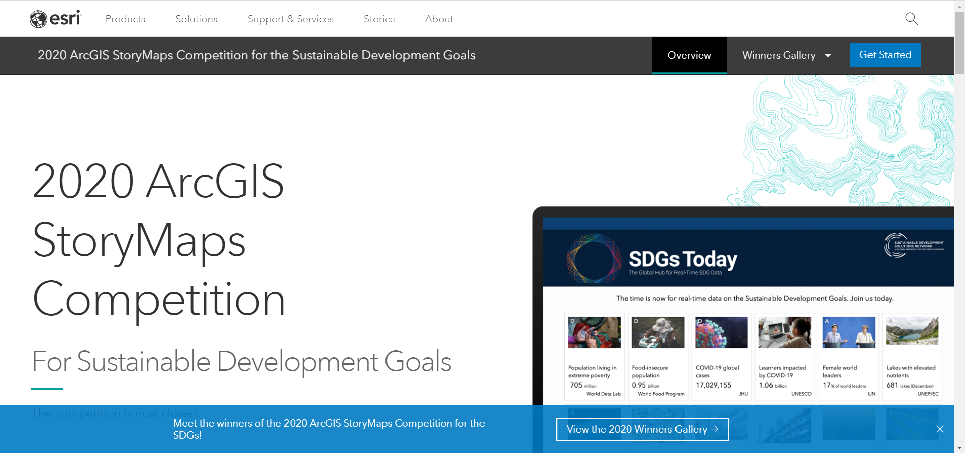
https://www.esri.com/en-us/arcgis/products/arcgis-storymaps/contest/gallery/2020-winners

Slide 9
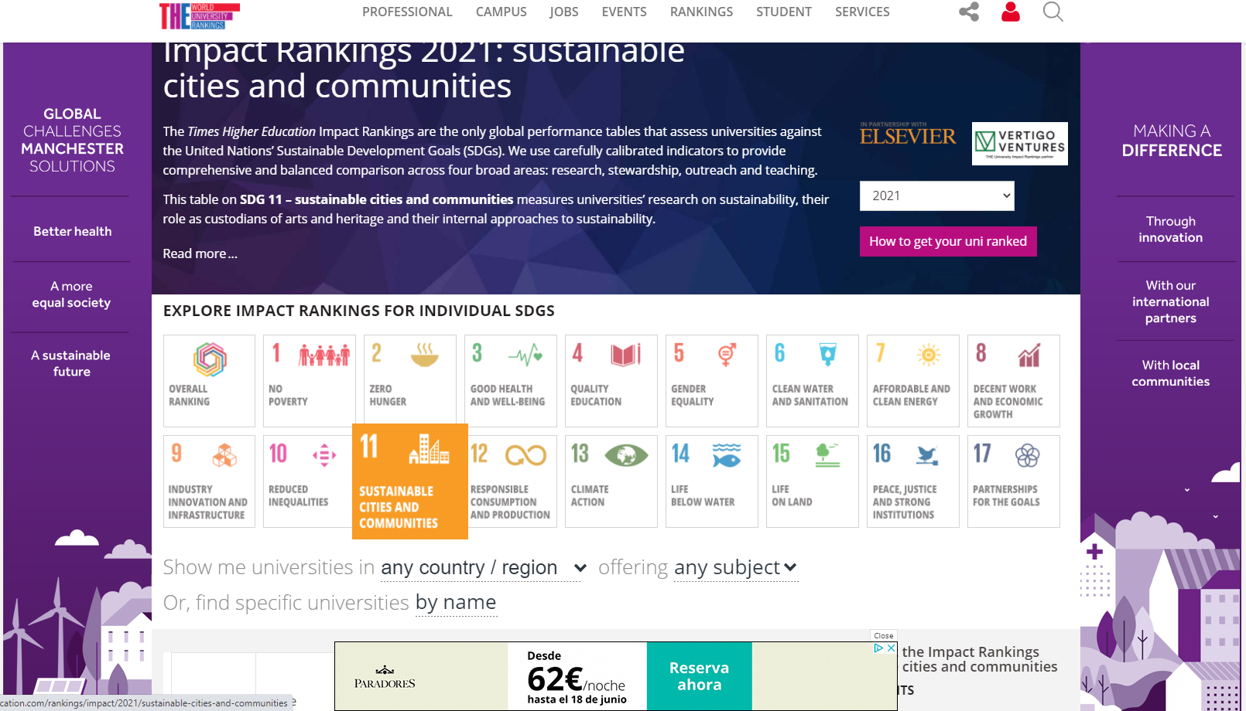
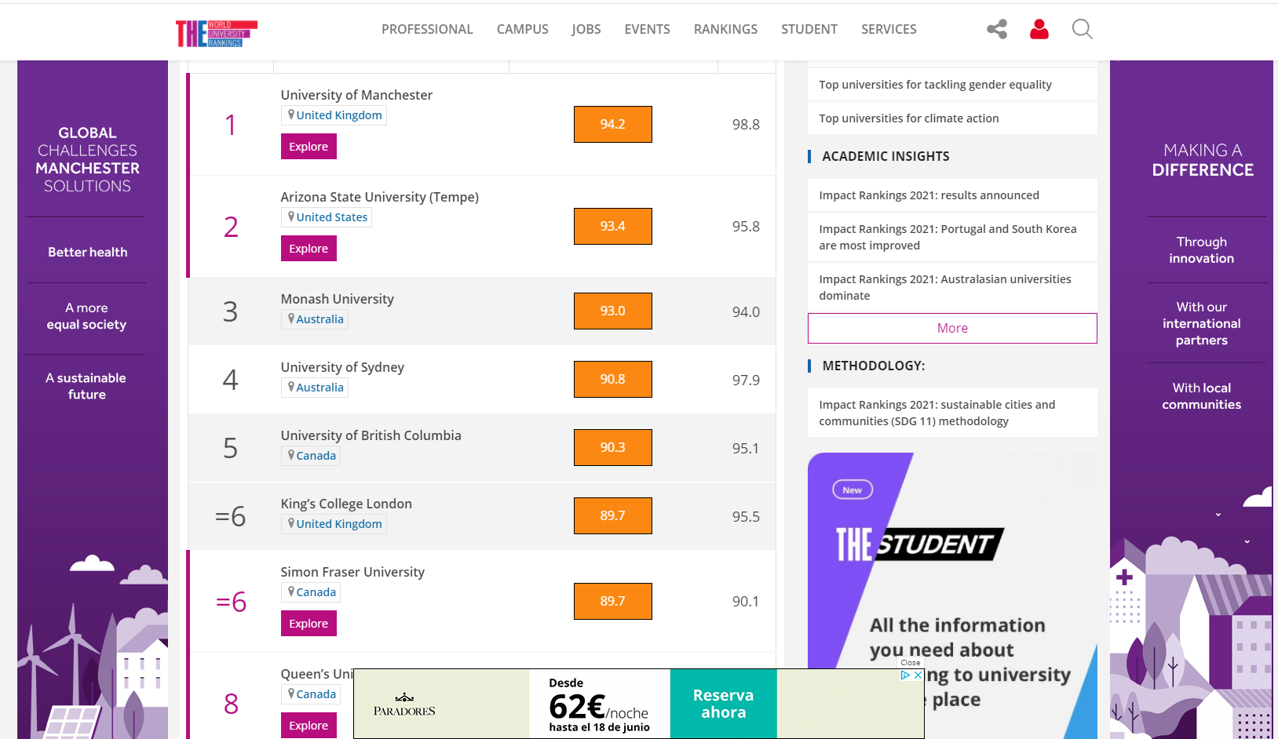
World University Ranking, by SDG.

Slide 10
Our World is Facing Serious Challenges
Economic
Jobs
Business Growth
Globalization
Budget
Unemployment
Environmental
Social
Trade
Energy
Human Health
Loss of Nature
Poverty
Land Use
Climate Changes
Education
Biodiversity
Water
Inequity
Natural Resources
Security
Pollution
Privacy
We Can Create a Better Future . . .
. . . Using GIS Science, Technology, and Education

Slide 11
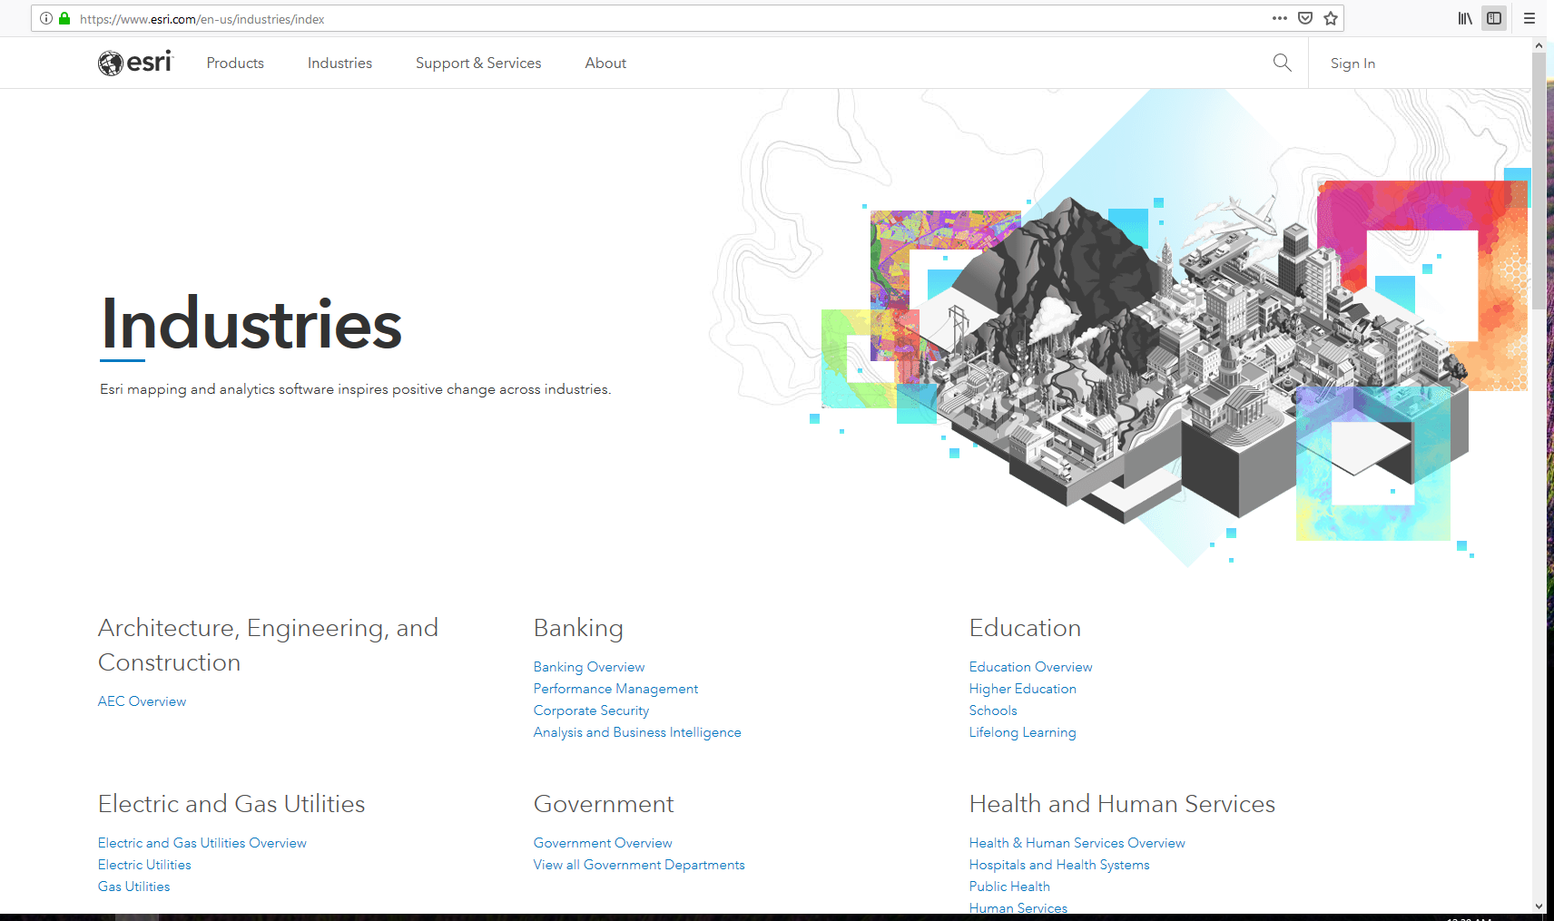
GIS Users in more than 40 Industries (sectors)
Notes:
There are millions of GIS users around the world. Esri has active user communities in many industry, education and government areas. On the Esri Industries website you can learn about all the interesting ways that professionals are applying ArcGIS to their daily problem-solving activities. Schools and universities need to be able to also cover this wide range of application areas.

Slide 12
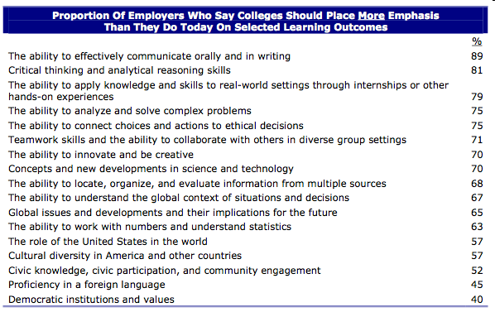
What employers want Hart Research Associates, “Raising the Bar” 2010
Notes:
So you can see that GIS is being used in many areas in business, government, and science. Using GIS in schools and universities helps to build problem-solving skills, which are very much in demand in the 21st Century.
This study shows that employers want graduates with skills in Critical Thinking and Analytical Reasoning. Working to solve problems with GIS helps to build these critical skills.

Slide 13
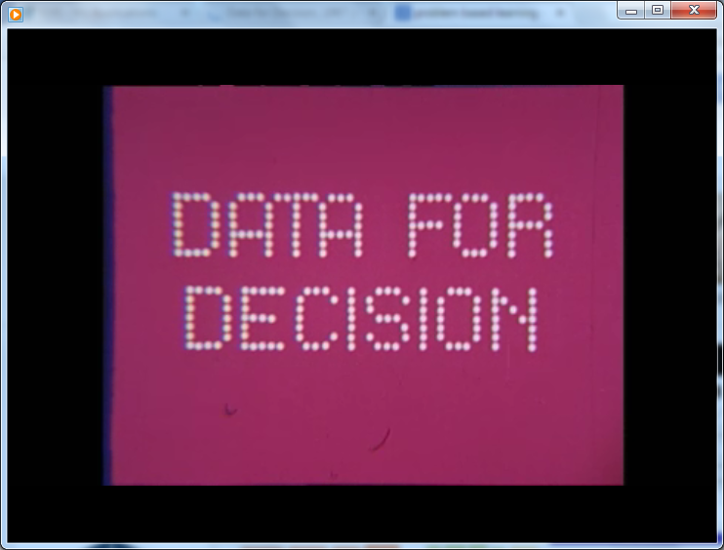
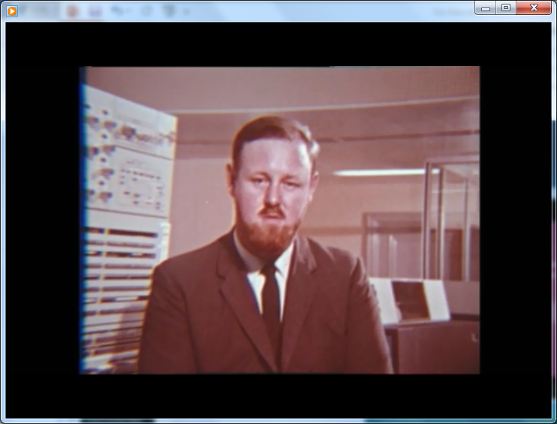
Canada GIS (circa 1967)
https://www.youtube.com/watch?v=eAFG6aQTwPk

Slide 14
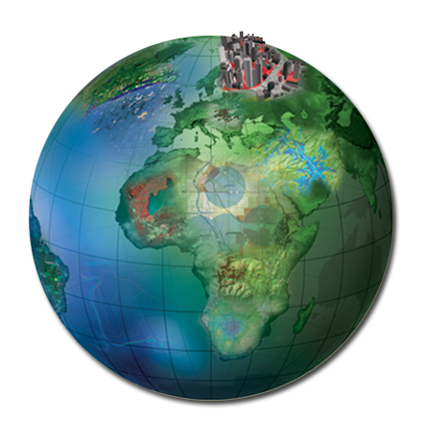
VISION
Circa 2010
Geographic
Knowledge
ACTION
Your Work is Geography in Action . . .
. . . But It’s Only the Beginning

Slide 15
Notes:
The Geographic Inquiry process has 5 steps or stages, and it is circular (it never stops). We ask questions about our world, then we Collect data in the world, then we Explore the data to try to create new information, then we Analyze the information and try to create new Knowledge. Importantly, students should not only store this new knowledge (for example, writing it in a notebook), but they should also consider Acting on the new Knowledge. How can this knowledge help us to improve neighborhood recycling, or to clean grafitti on the walls, or where should more trees be planted? After students have acted, and made a small change in their world, then the process continues around in another cycle.

Slide 16
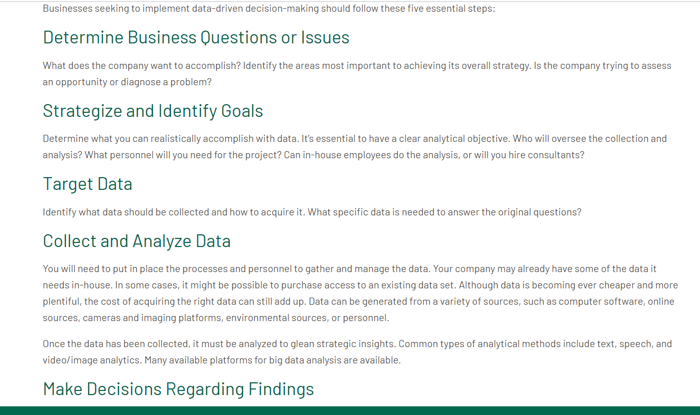
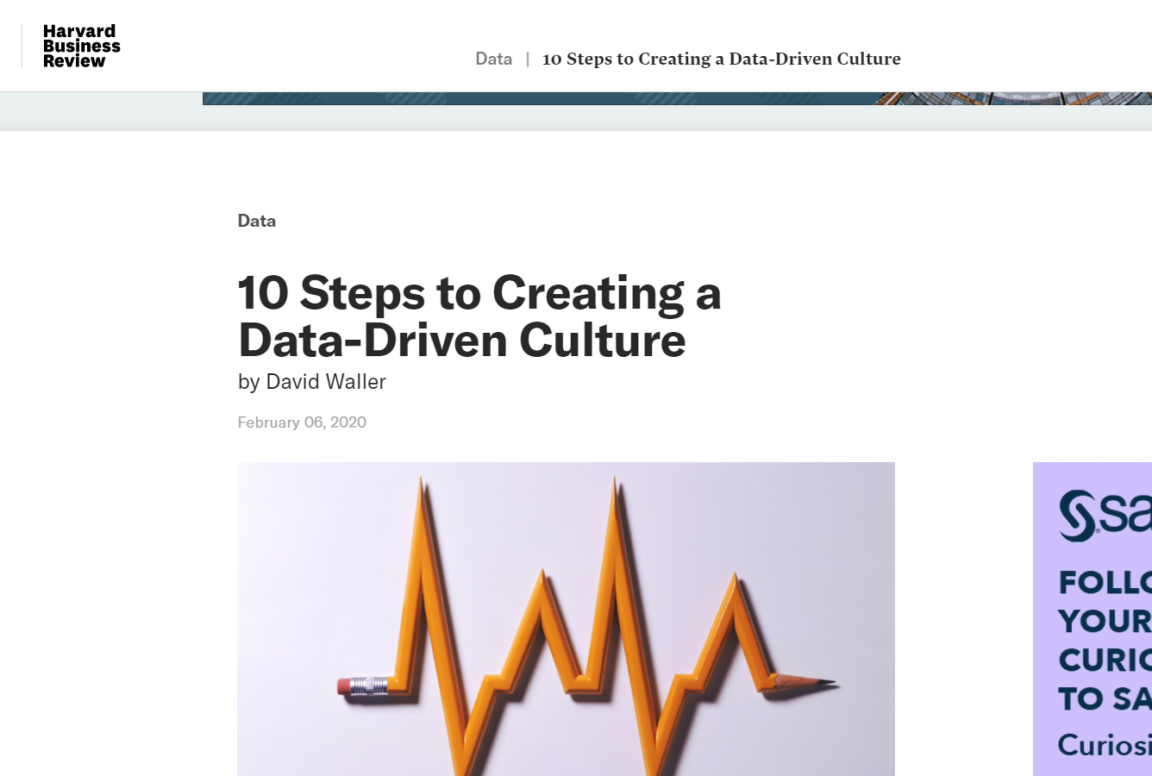

Slide 17
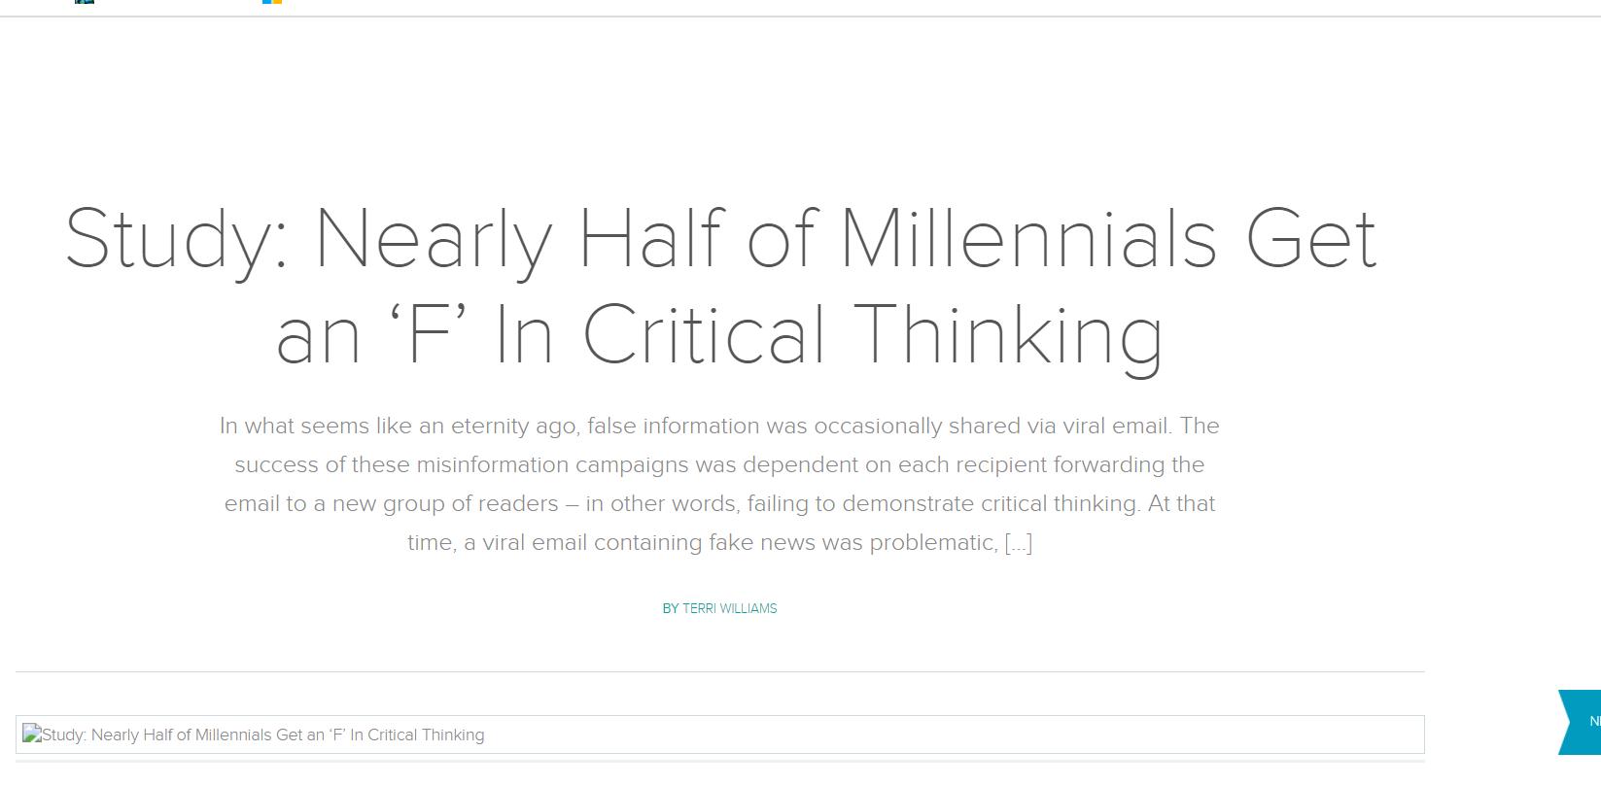
Out of Scope (but important): Students’ Lack of Critical Thinking

Slide 18
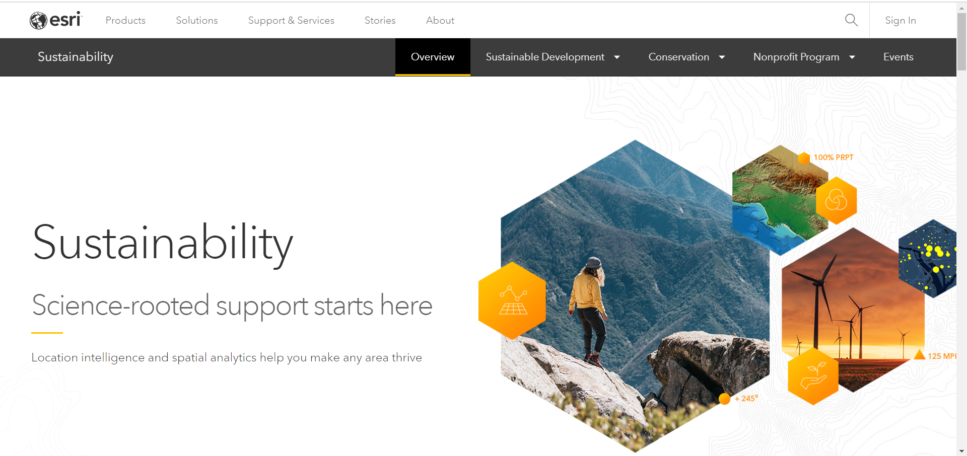
https://www.esri.com/en-us/industries/sustainability/overview

Slide 19
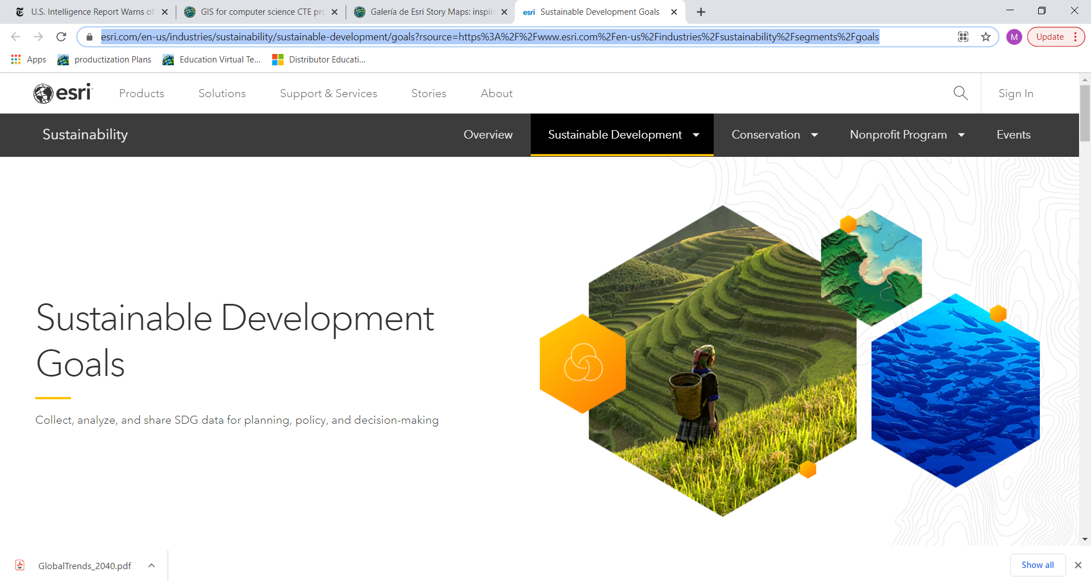
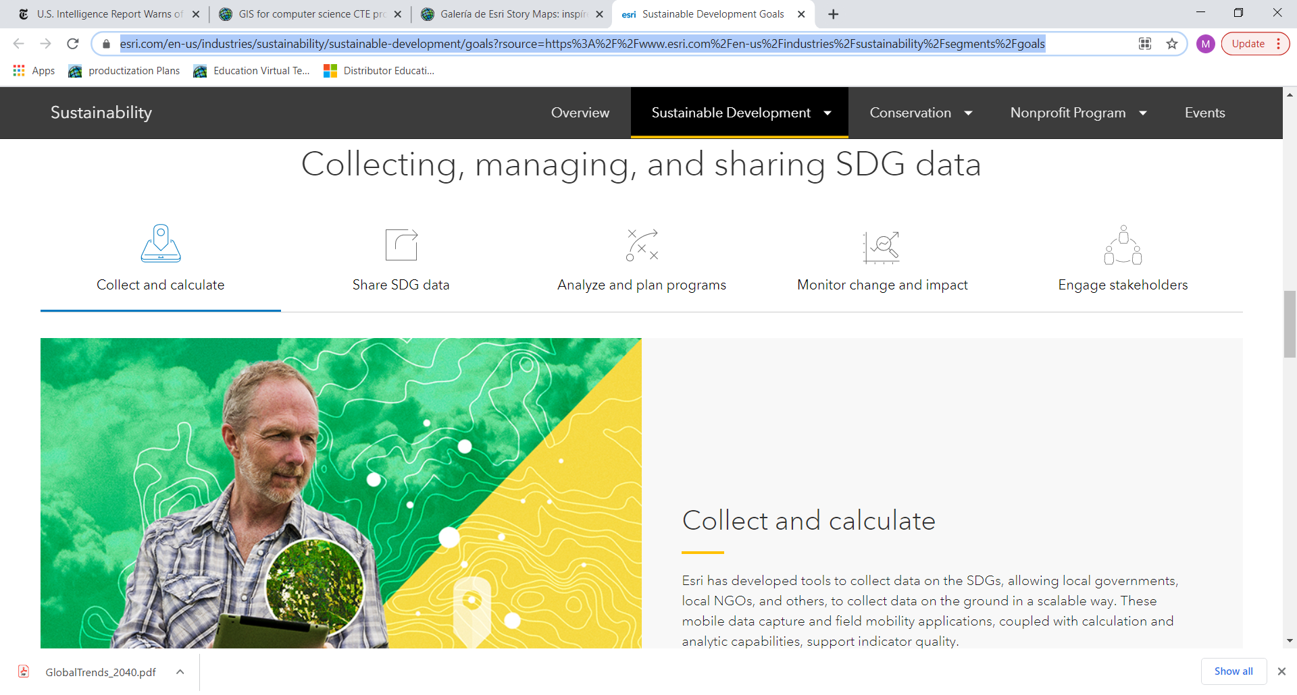
https://www.esri.com/en-us/industries/sustainability/sustainable-development/goals?rsource=https%3A%2F%2Fwww.esri.com%2Fen-us%2Findustries%2Fsustainability%2Fsegments%2Fgoals

Slide 20
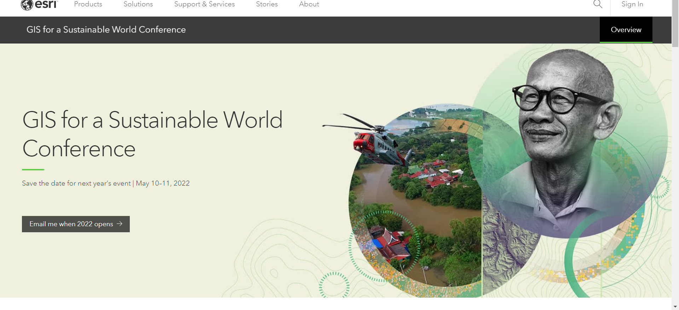
https://www.esri.com/en-us/about/events/gis-sustainable-world/save-date

Slide 21
Changes in the Past Decade
GIS is now Online.
Data Availability!!
Imagery: Sentinel, Data Cubes
GPS on your phone
OSM
StreetView, Mapillary
UAVs, drones
National Statistics
Realtime traffic, weather, river gauges, …
Commercial
Specifc SDG-related

Slide 22
GIS is Online
Easier to acquire, maintain; no installation needed.
Access GIS functionality Anytime, Anywhere, (almost) any Device.
Software as a Service (SaaS) model: you have a user ID that travels with you.
Facilitates “flipped classroom” models.
Saved many GIS-related programs affected by COVID19 school closings.
Functionality is growing: Analysis tools, not only Cartographic visualization
Here featuring ArcGIS Online, integrated in ArcGIS ecosystem.
Special pricing for Education, NGOs, Conservation groups, etc.
Other non-Esri options exist

Slide 23
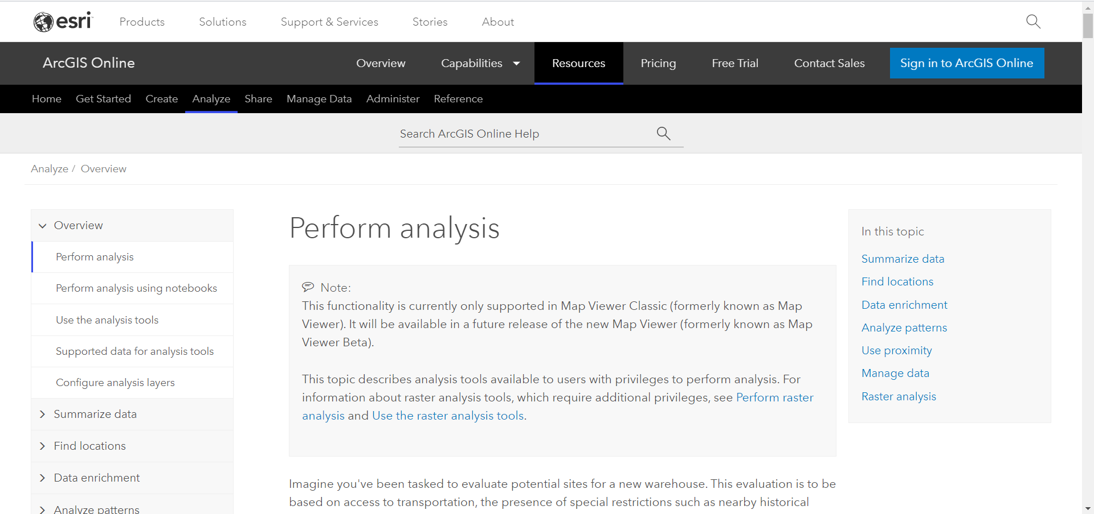
ArcGIS Online analysis, documentation
https://doc.arcgis.com/en/arcgis-online/analyze/perform-analysis.htm

Slide 24
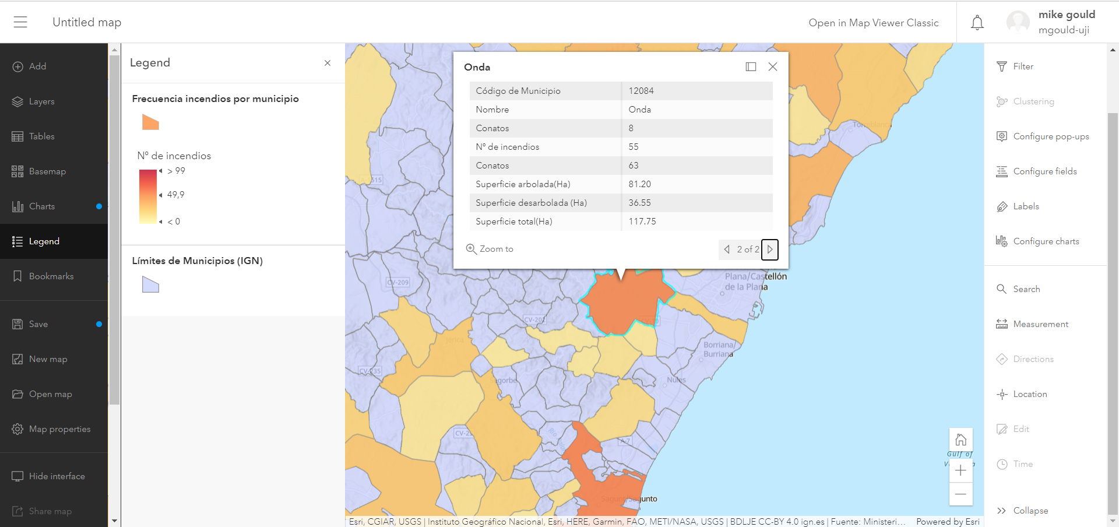
ArcGIS Online
Search layers for forest fires in Spain, Filter municipalities with > 10 fires.

Slide 25
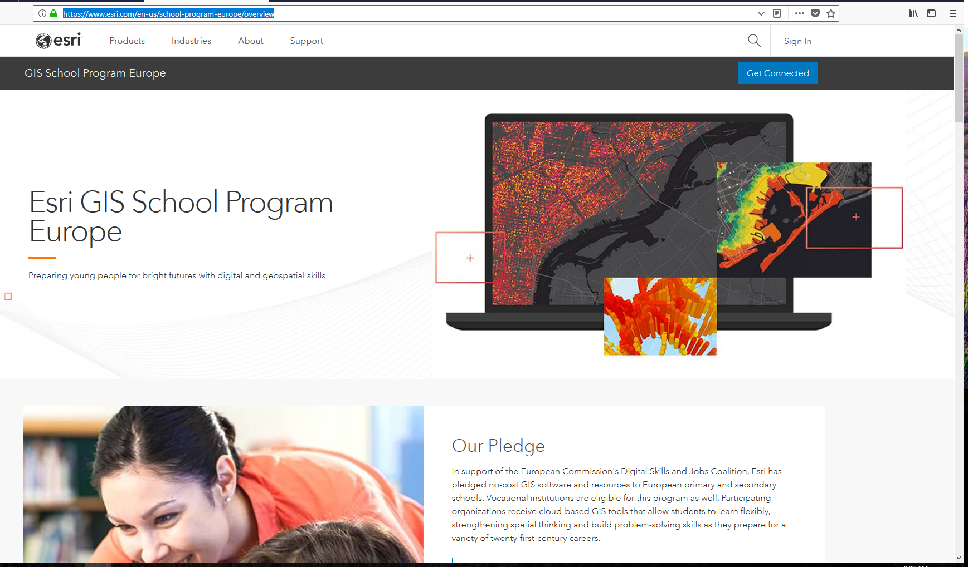
https://www.esri.com/en-us/school-program-europe/overview

Slide 26
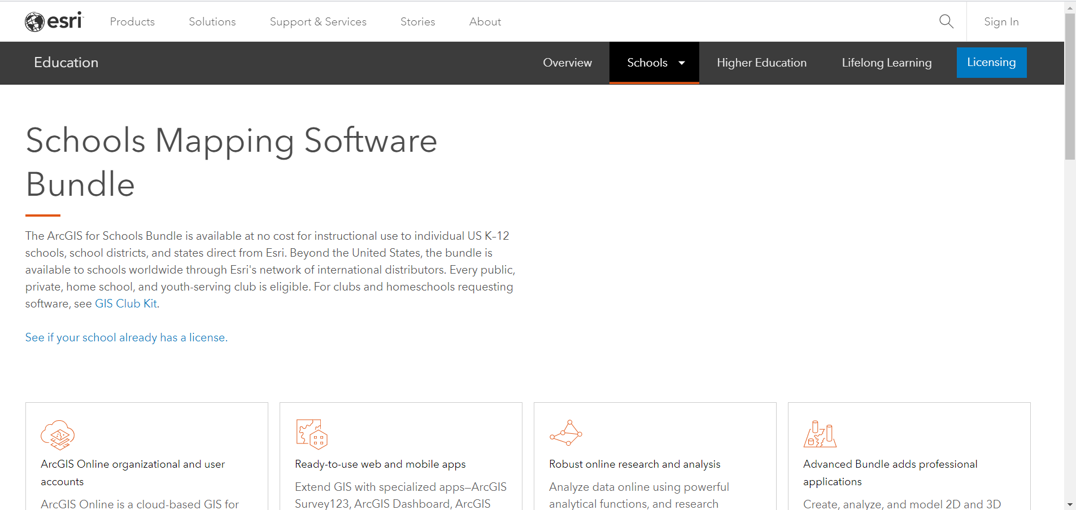
Online (and Desktop) GIS for Schools (worldwide)

Slide 27
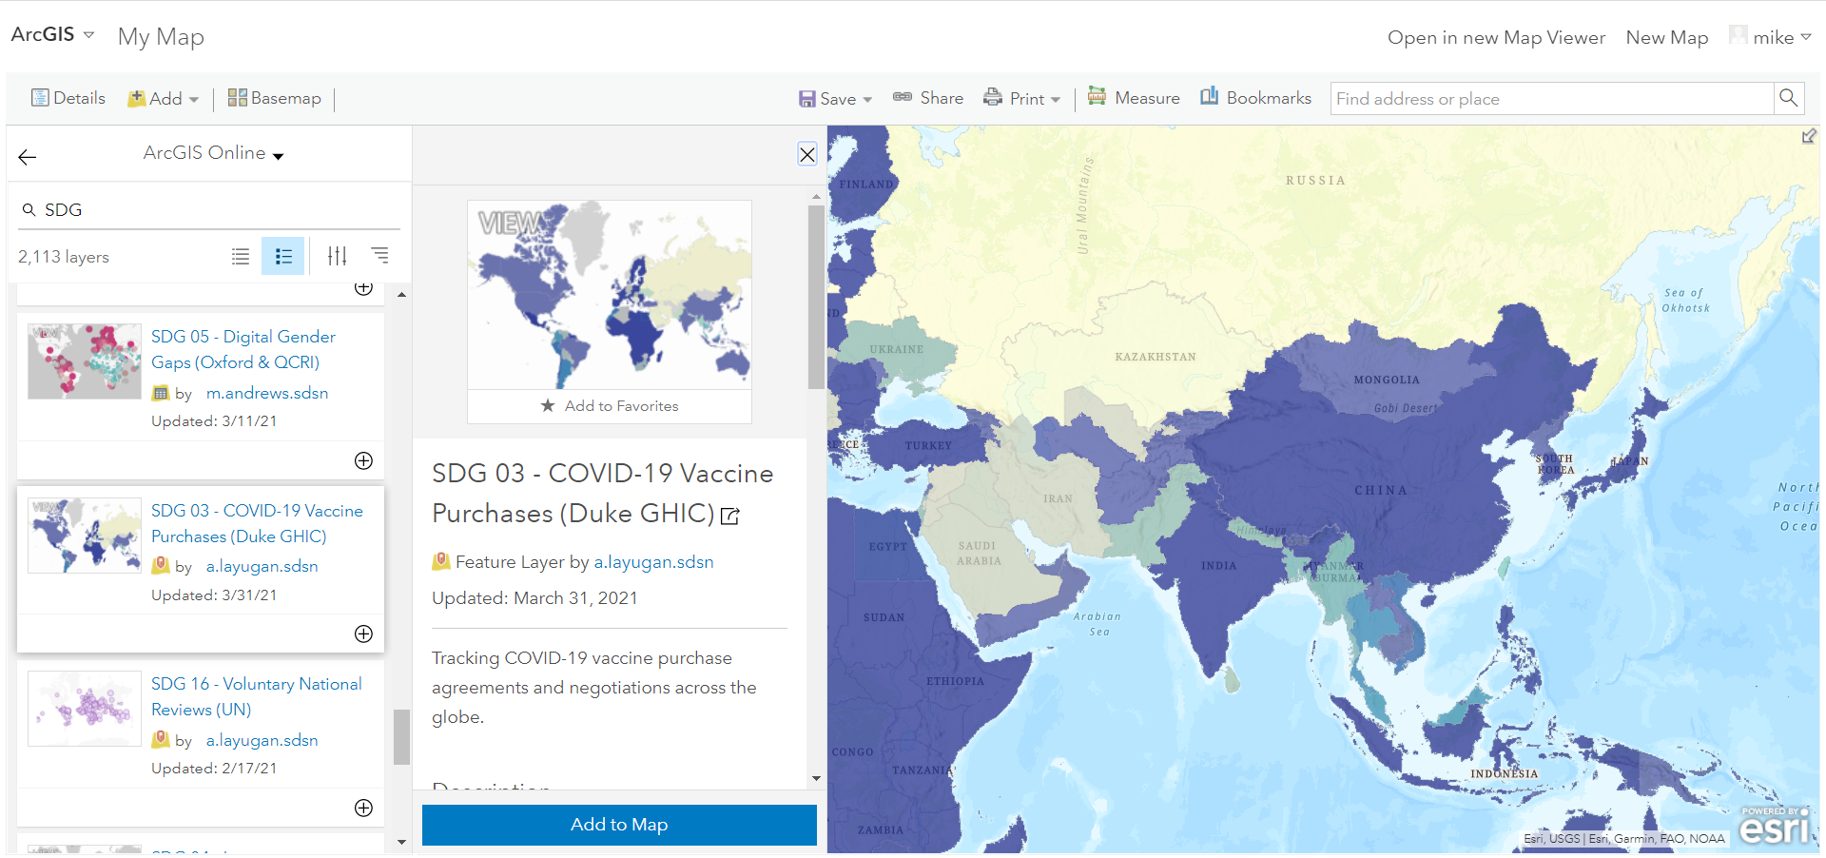
ArcGIS Online
Search layers on “SDG”

Slide 28
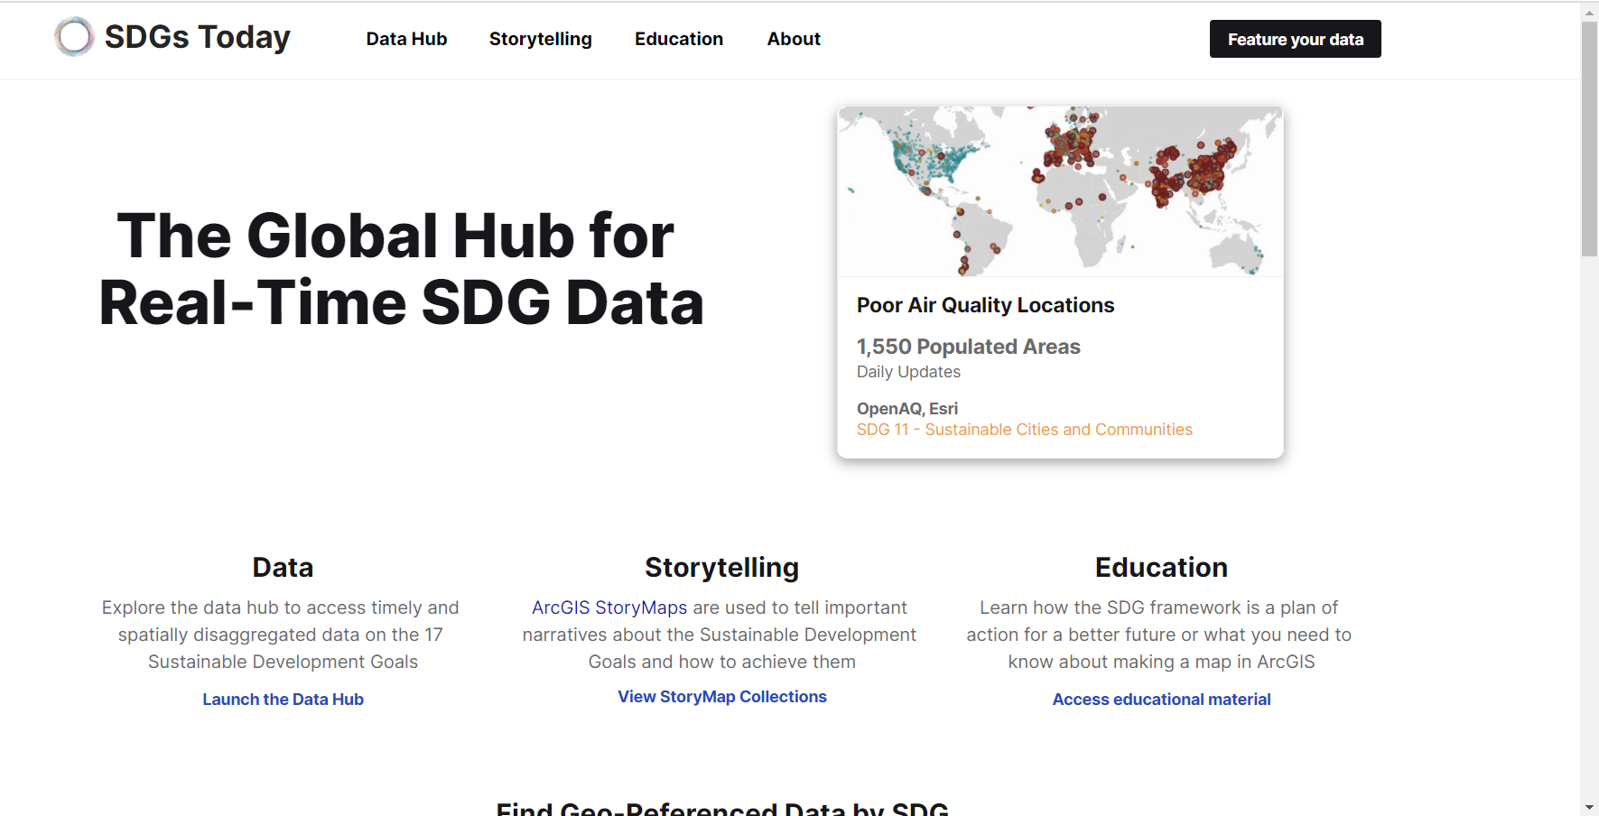
https://sdgstoday.org/ Curated SDG data (SDSN + Esri)

Slide 29
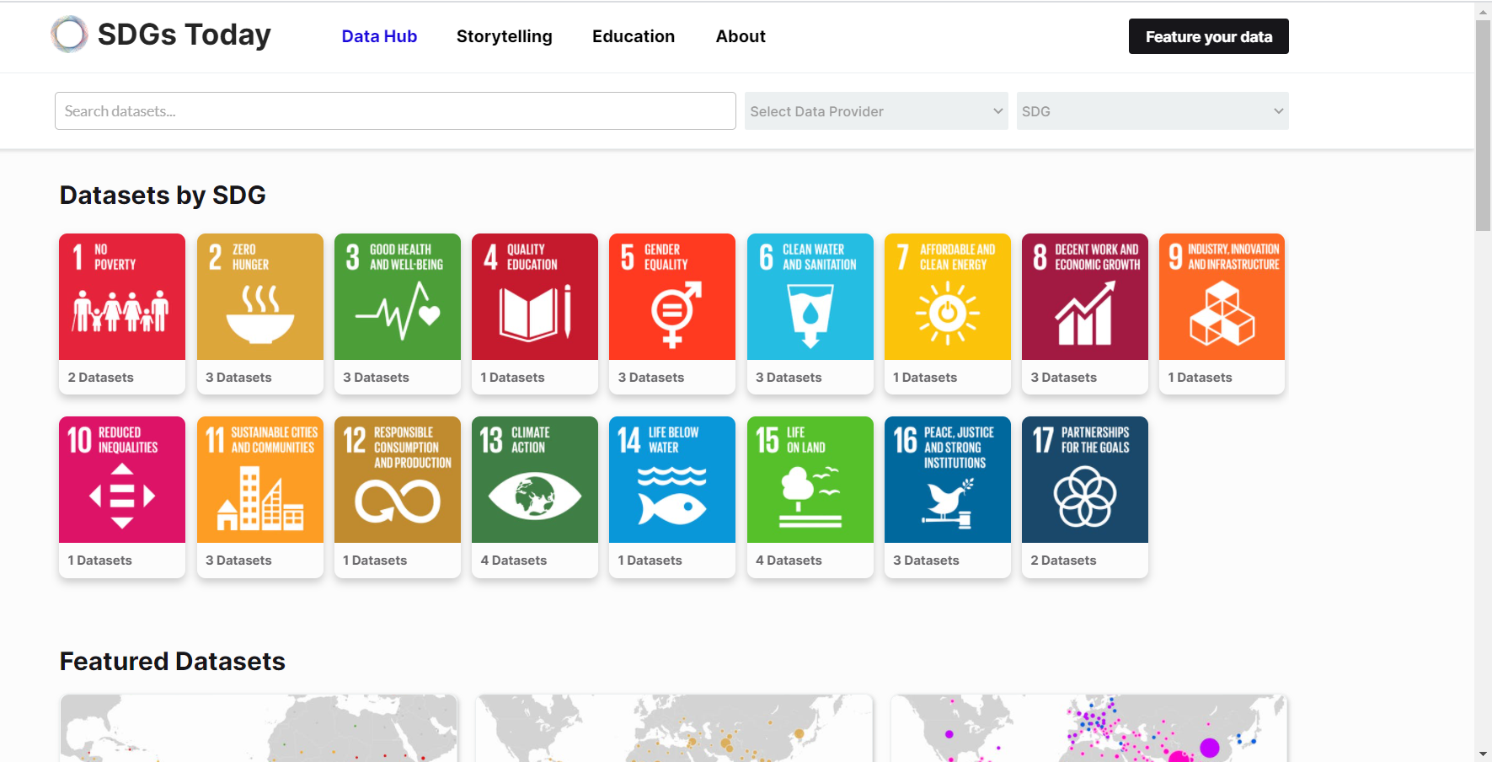
Datasets relevant to each SDG
https://sdgstoday.org/dataset-hub

Slide 30
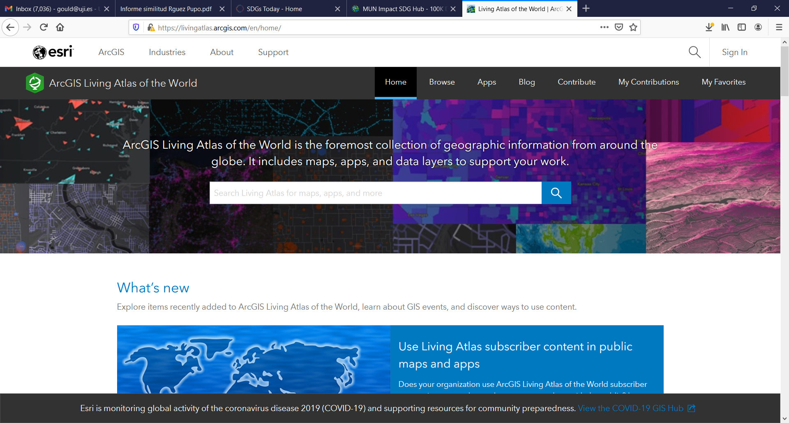
Living Atlas of the World
https://livingatlas.arcgis.com/en/home/
Curated collection of geodata
Much is Analysis Ready Data

Slide 31
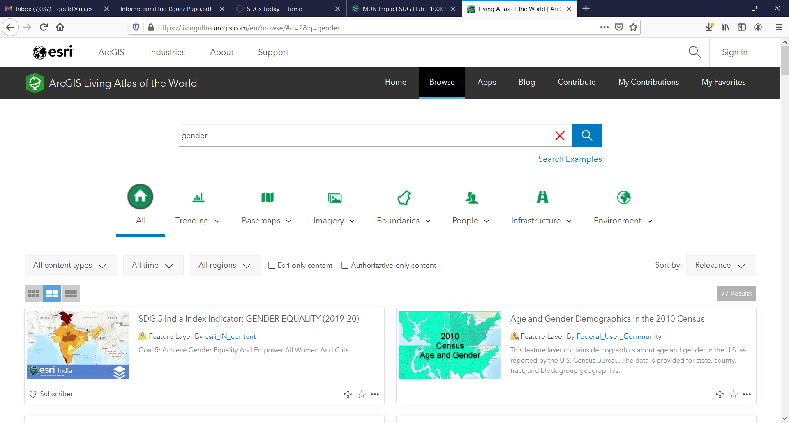

Slide 32
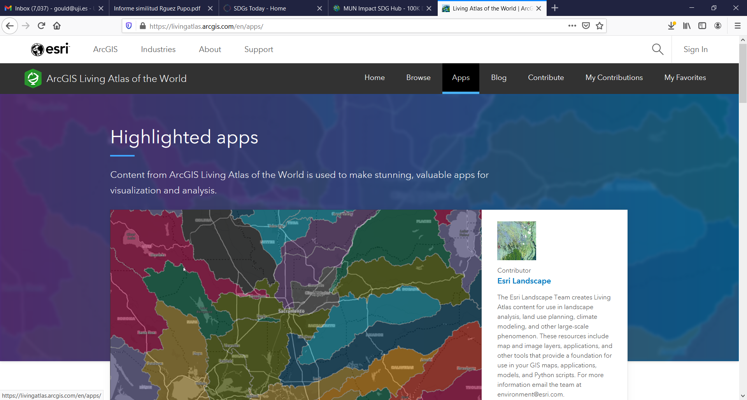
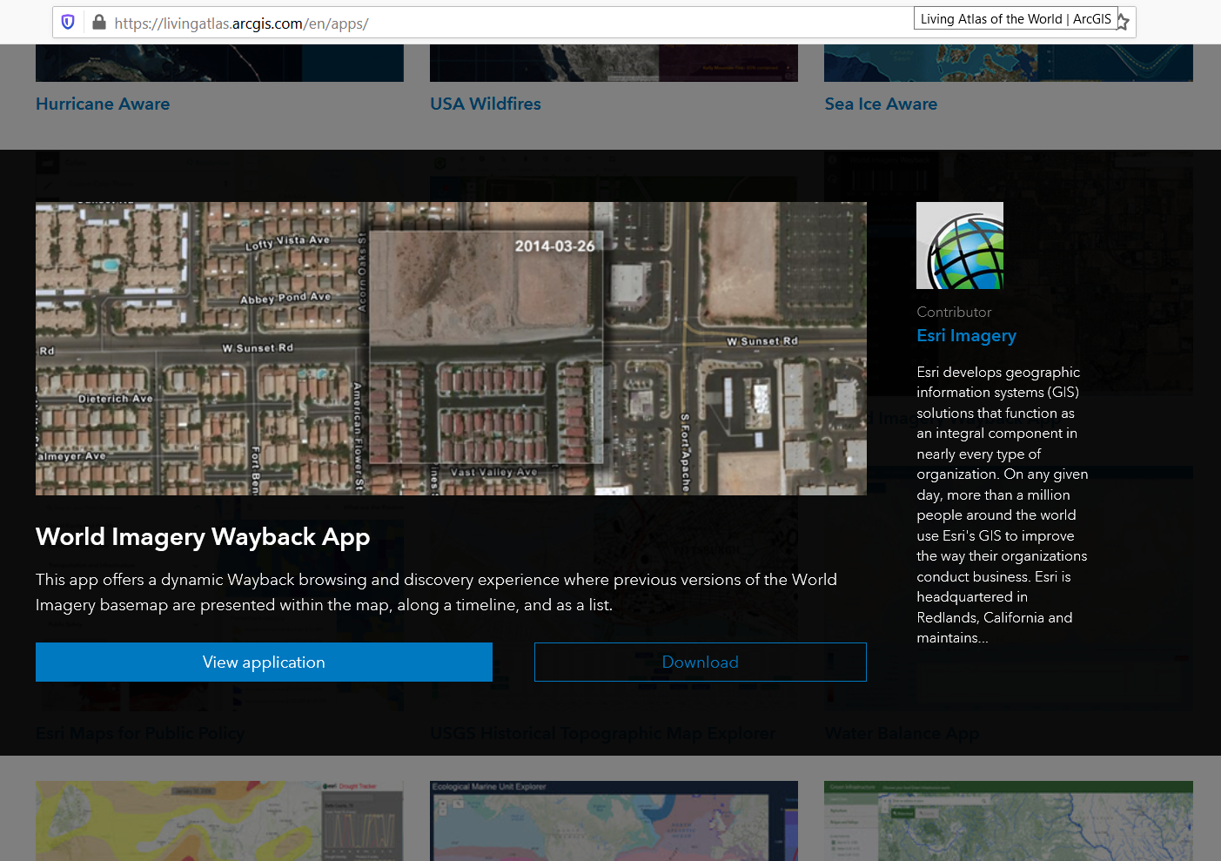
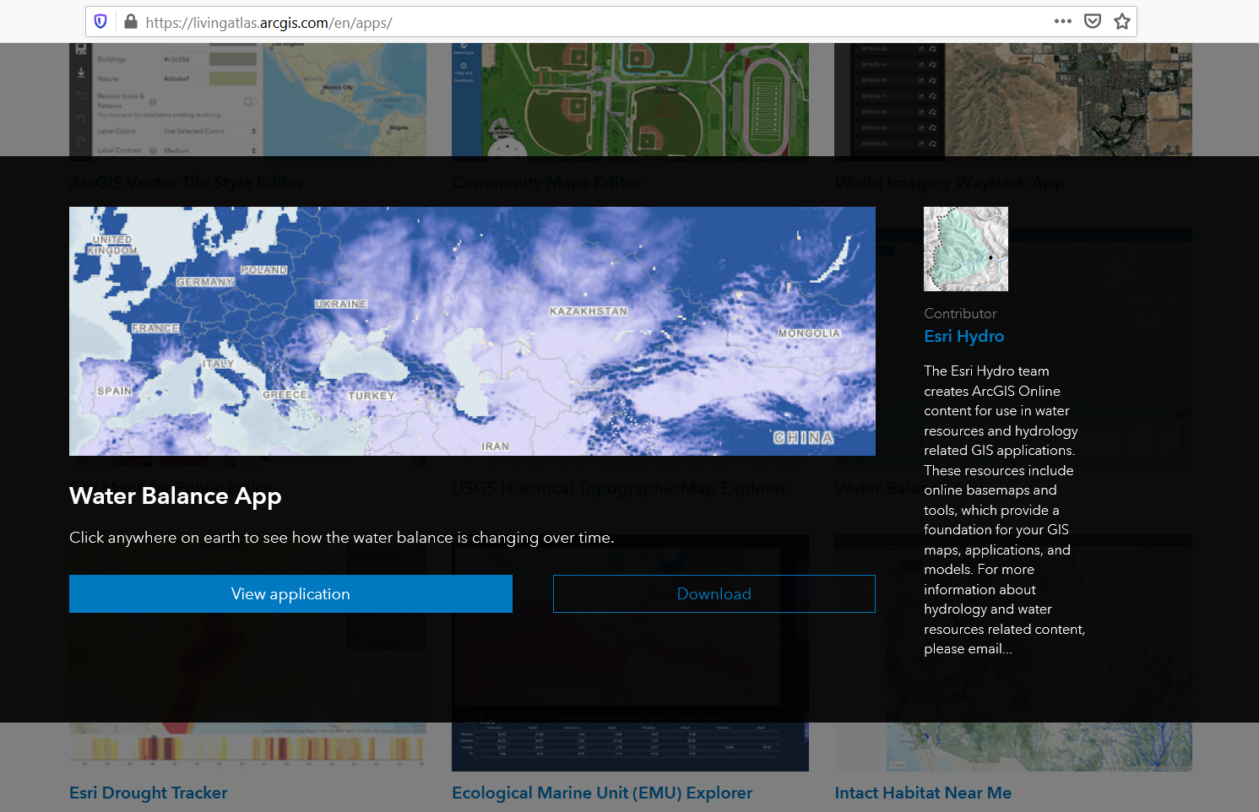
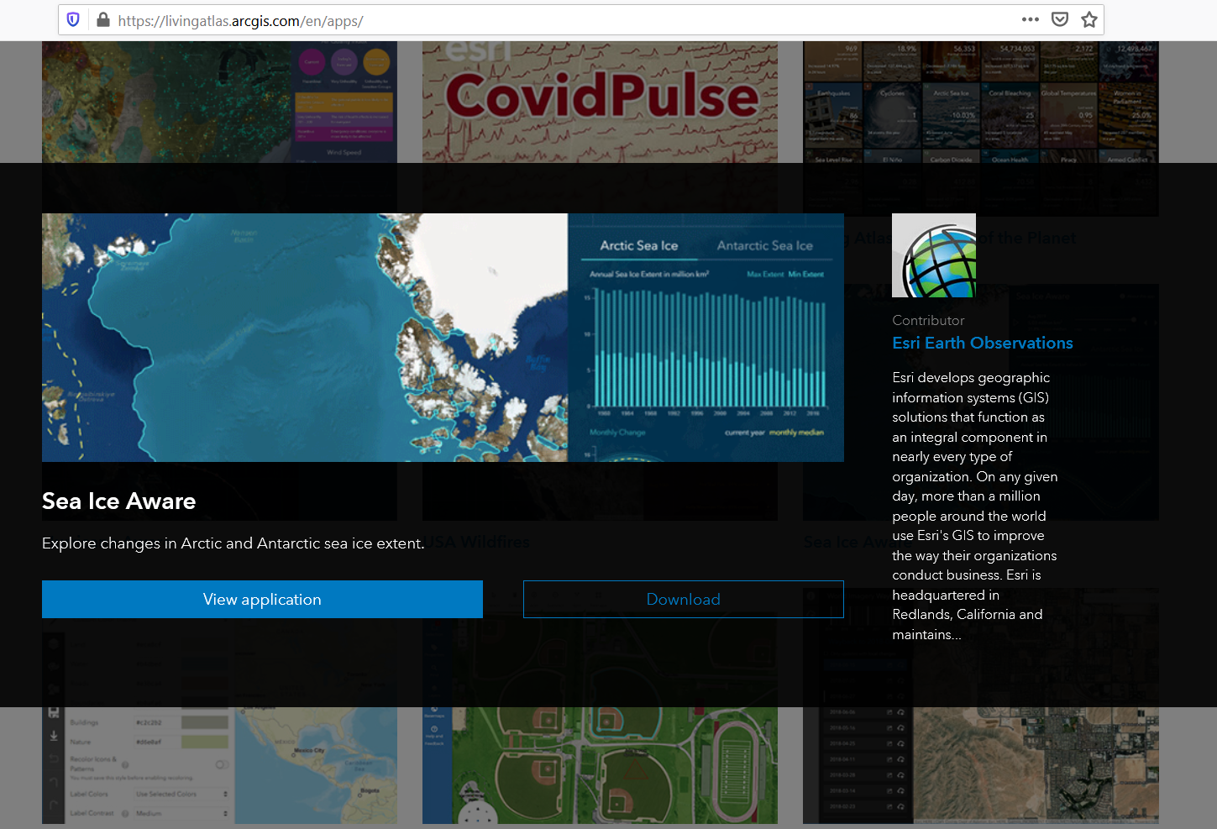
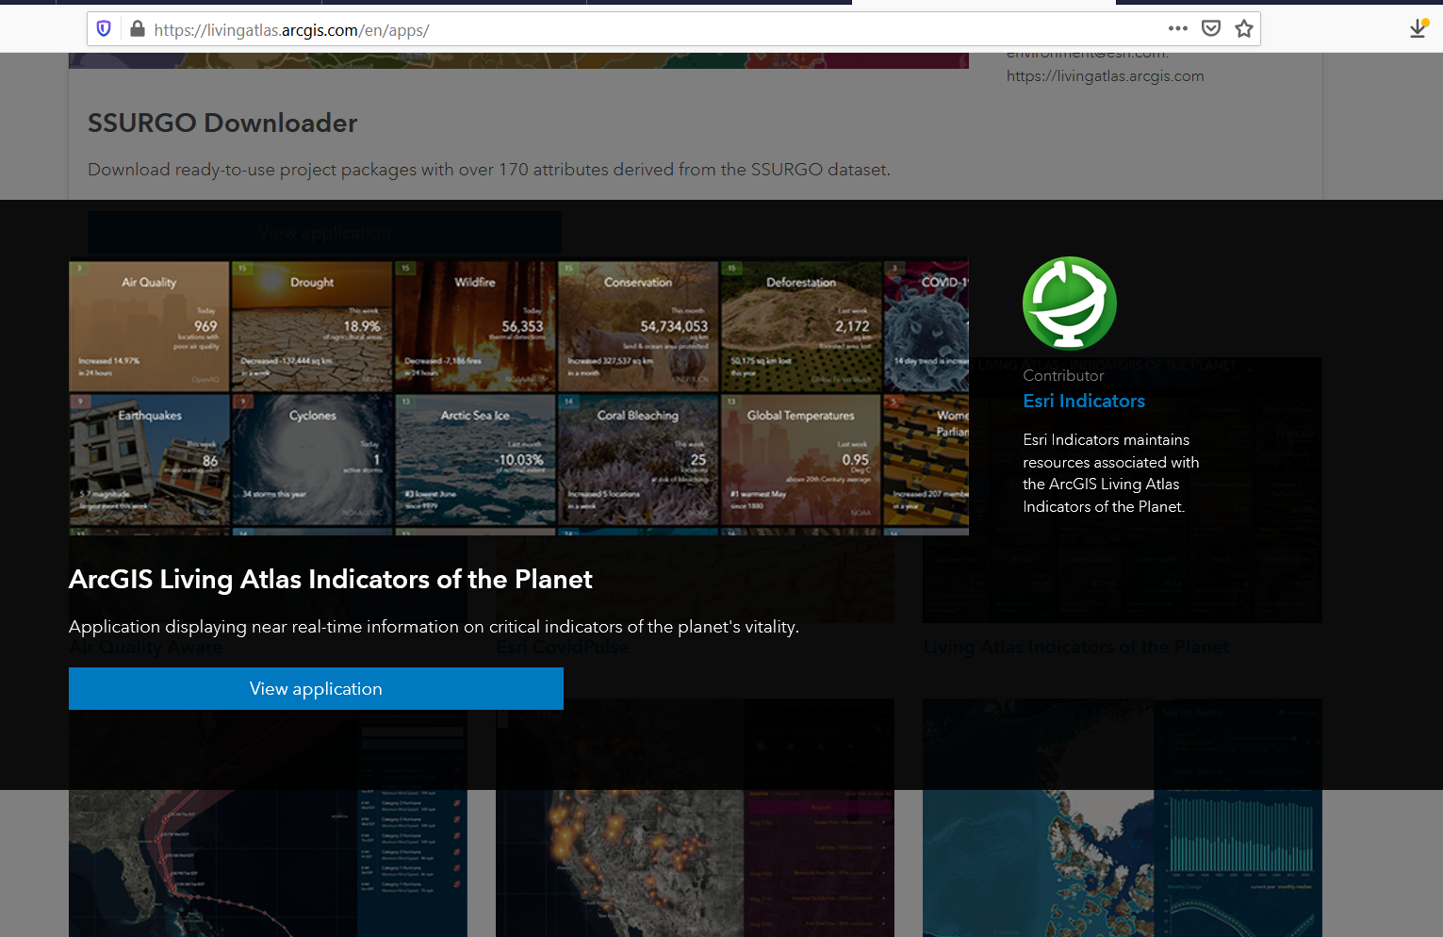

Slide 33
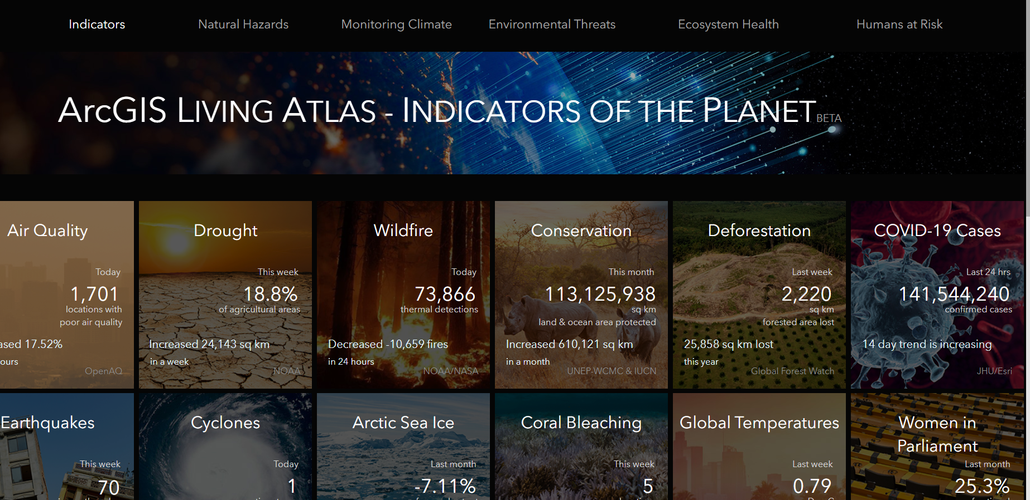
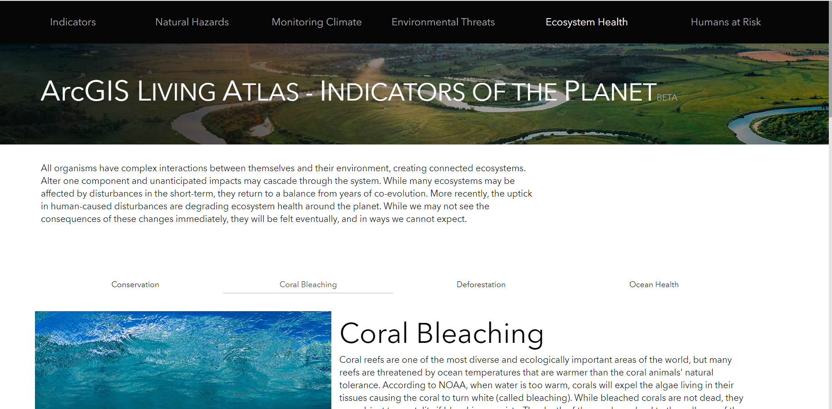
Living Atlas Subset: Indicators of the Planet
https://experience.arcgis.com/experience/003f05cc447b46dc8818640c38b69b83/page/page_0/?views=view_14

Slide 34
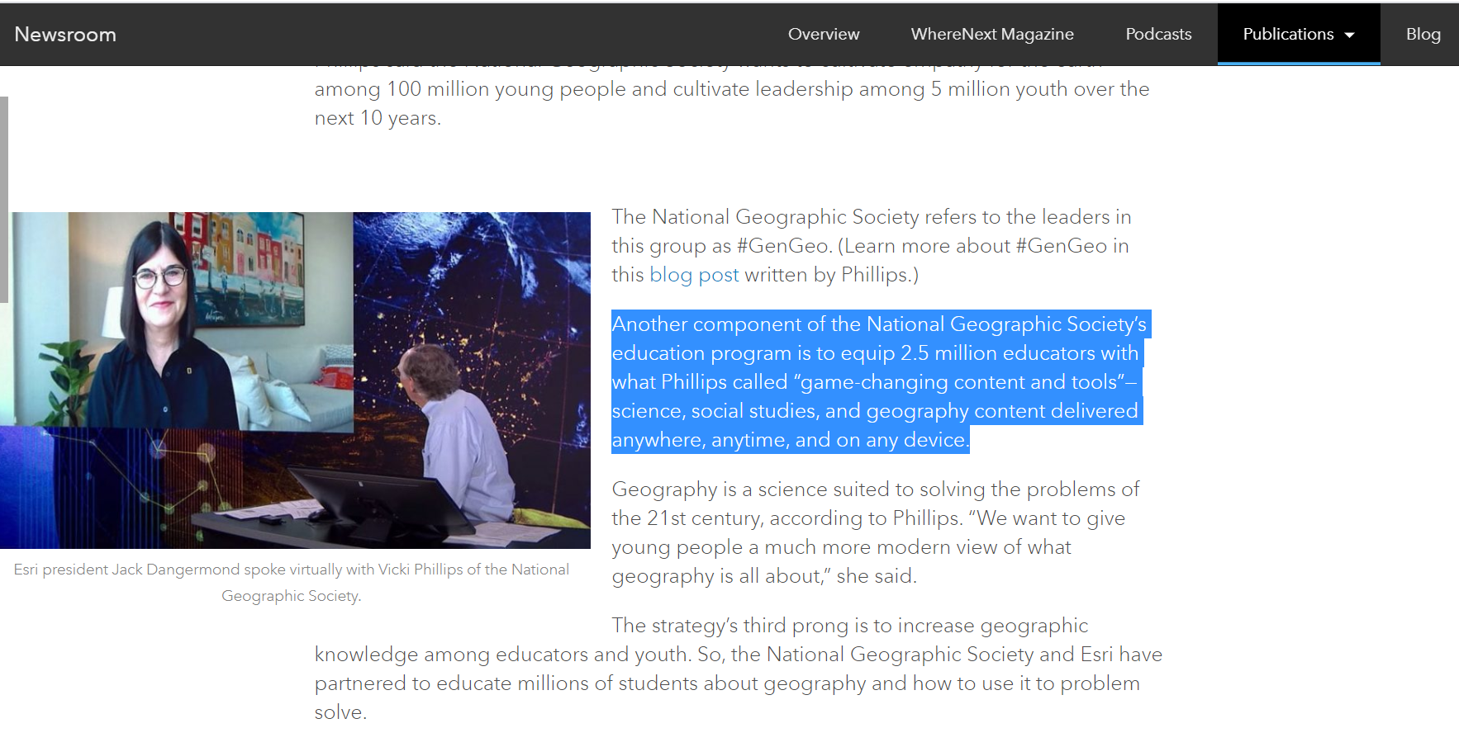
Coming Soon: National Geographic Society + Esri Resources
https://www.esri.com/about/newsroom/arcwatch/moving-toward-a-global-gis/

Slide 35
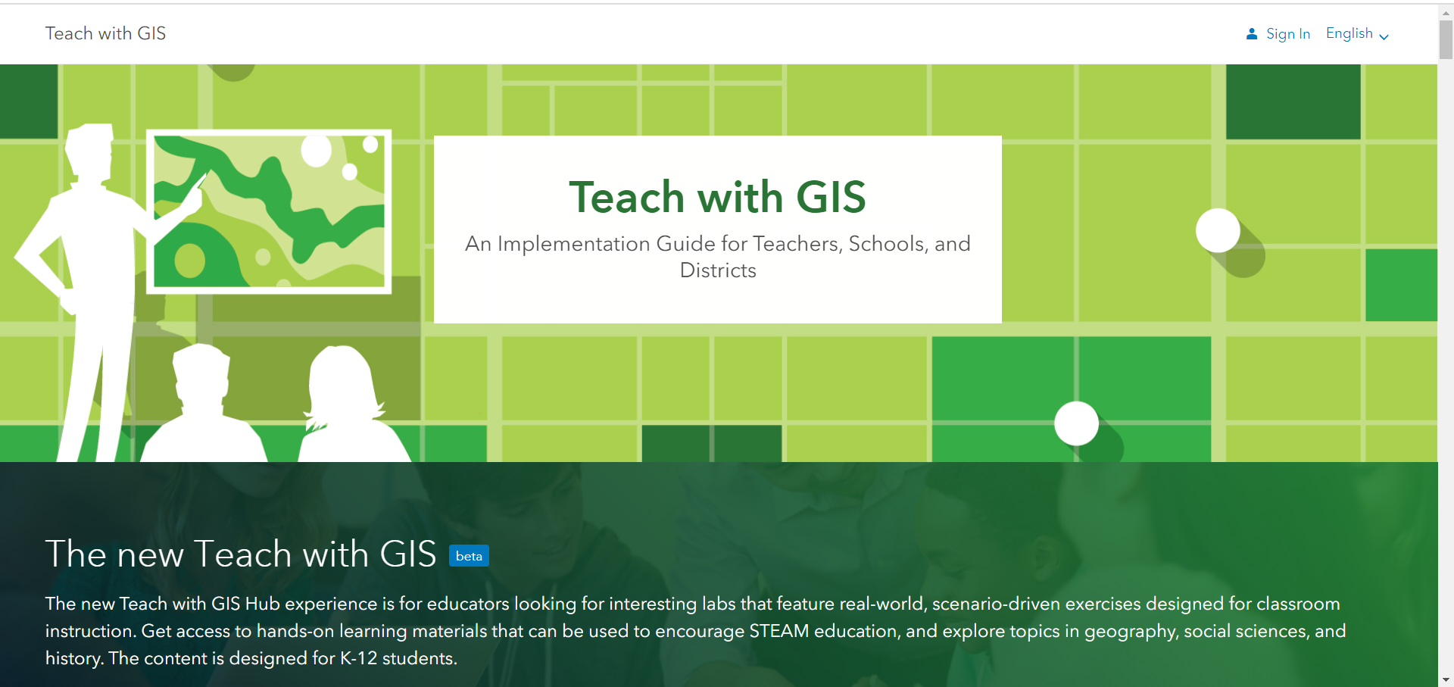
https://learn.arcgis.com/en/educators/

Slide 36
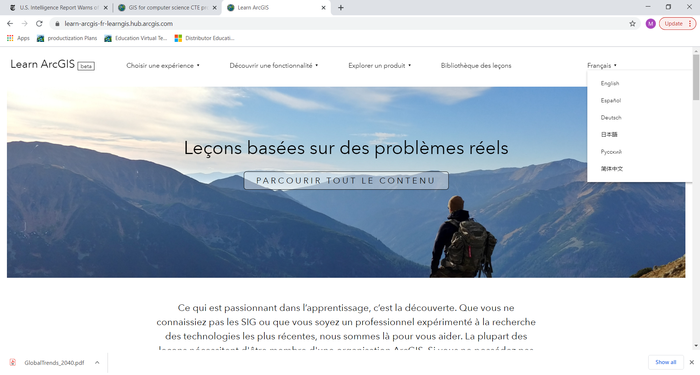
Learn.arcgis.com
Free lessons
Data and software provided
Multilingual
Multiple filters for topics, levels, software,…

Slide 37
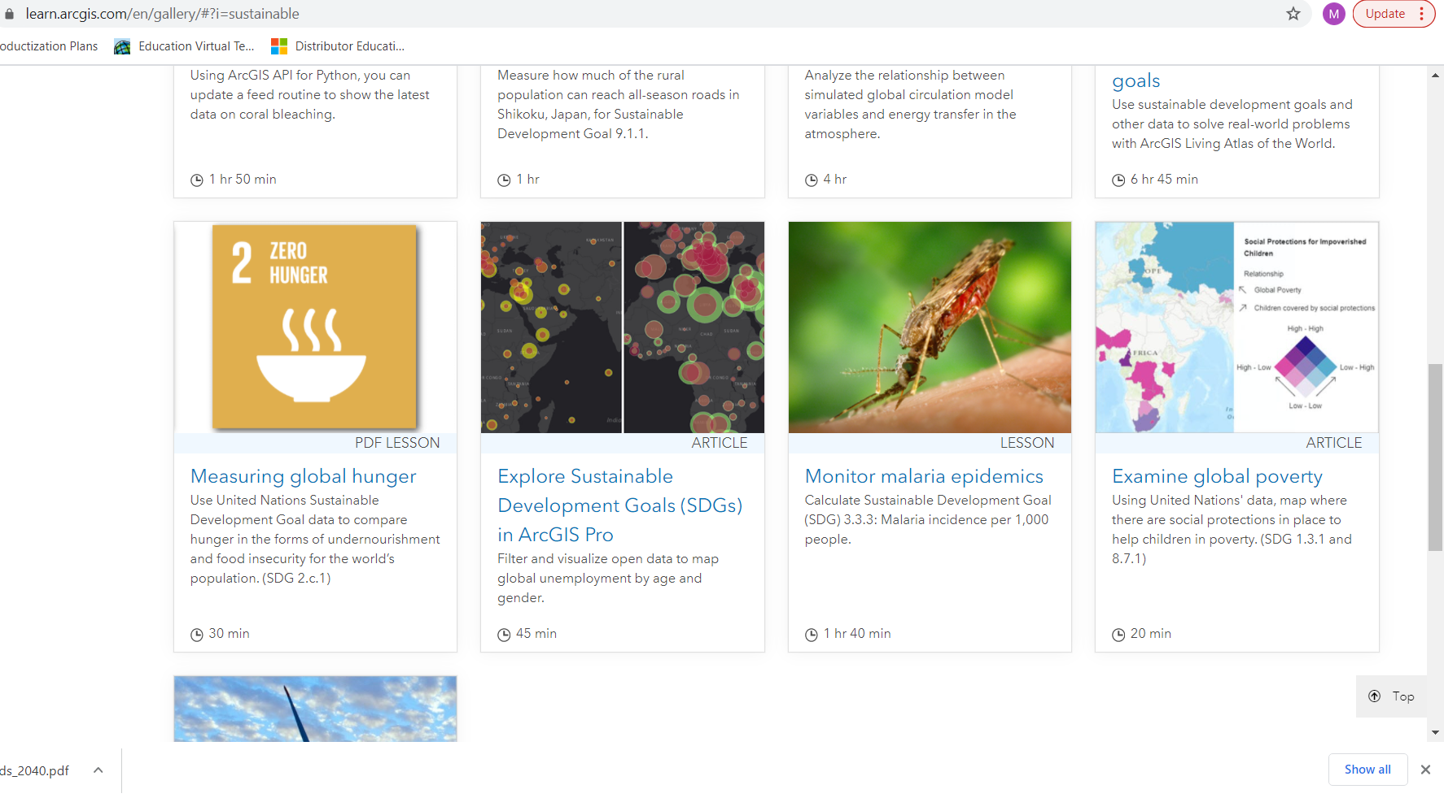
Filter on Sustainable Development…

Slide 38
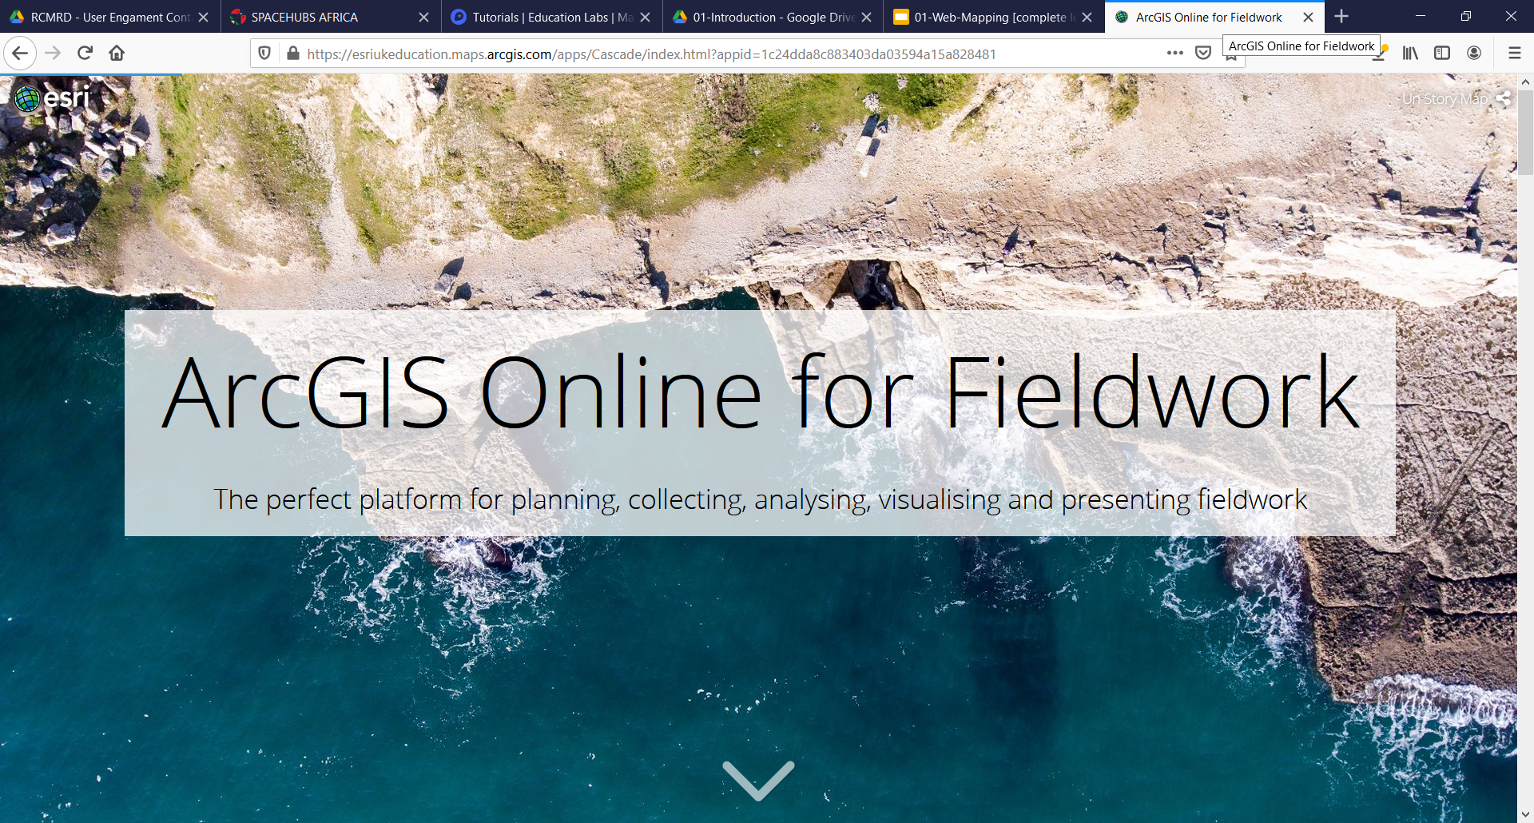
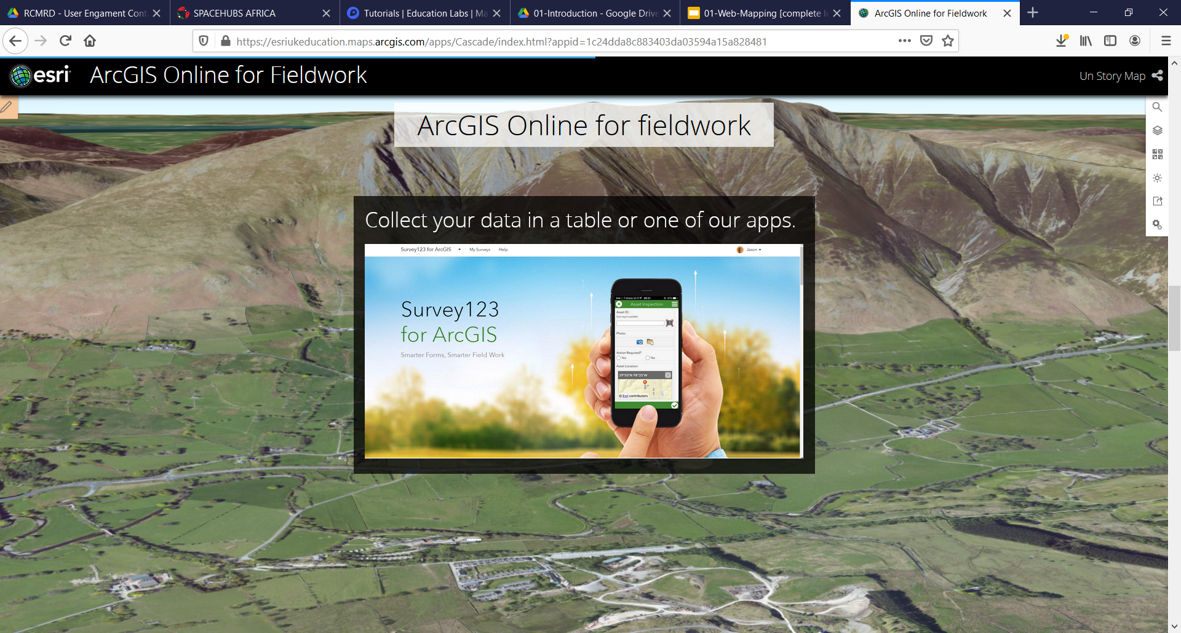
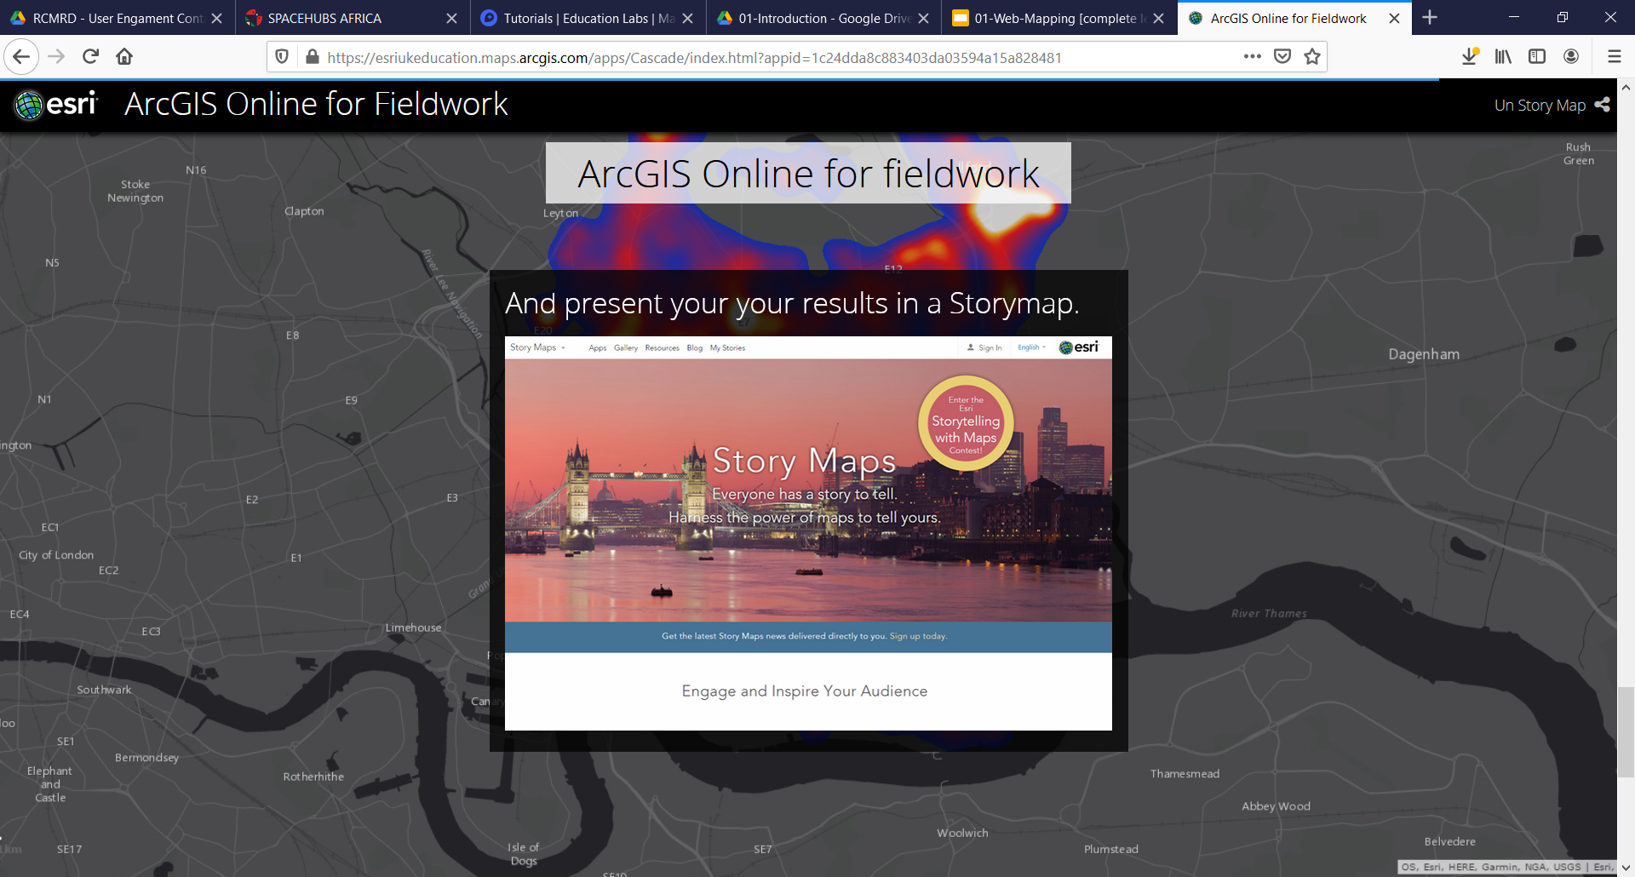
Fieldwork: Collect your own SDG-related data!
https://esriukeducation.maps.arcgis.com/apps/Cascade/index.html?appid=1c24dda8c883403da03594a15a828481
Think of local data that are connected to an SDG…

Slide 39
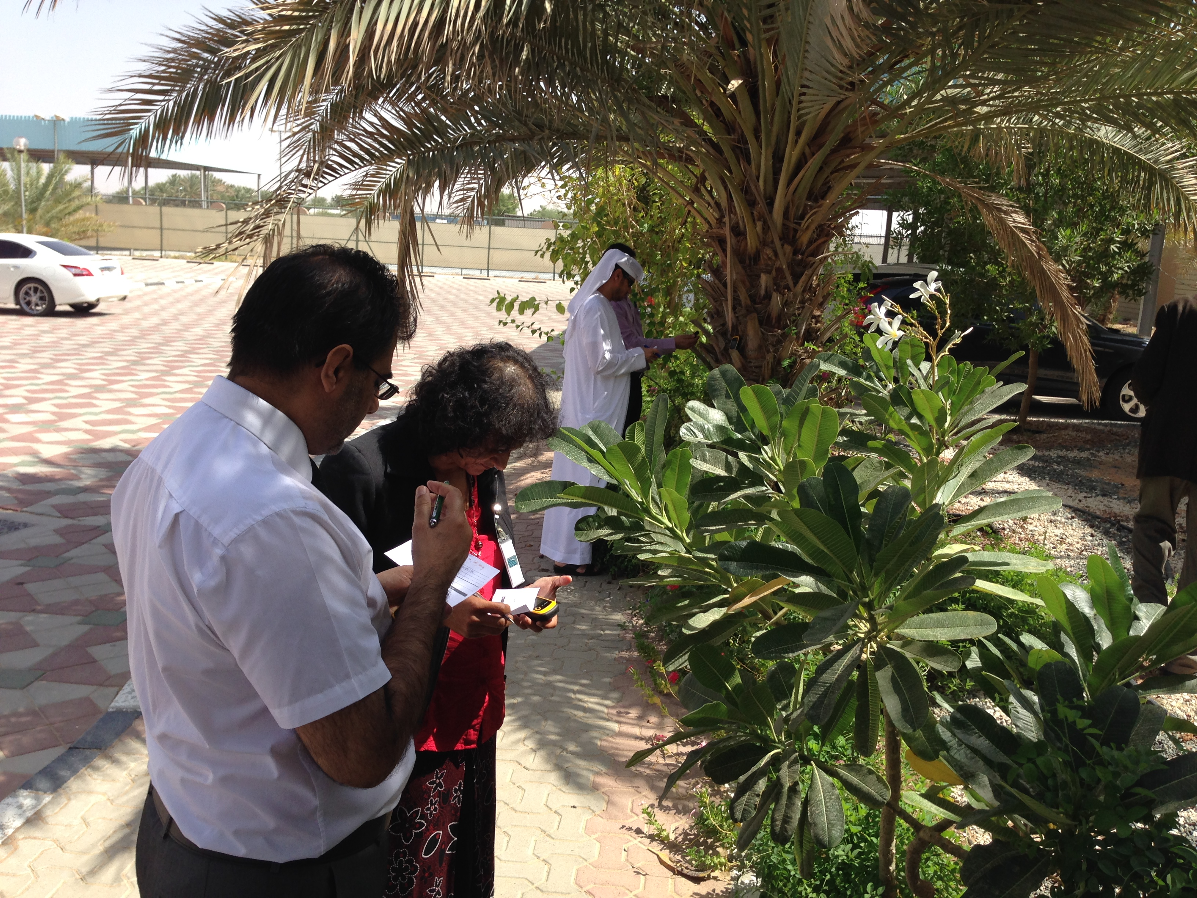
TEACHER TRAINING ON PROBLEM-BASED LEARNING

Slide 40
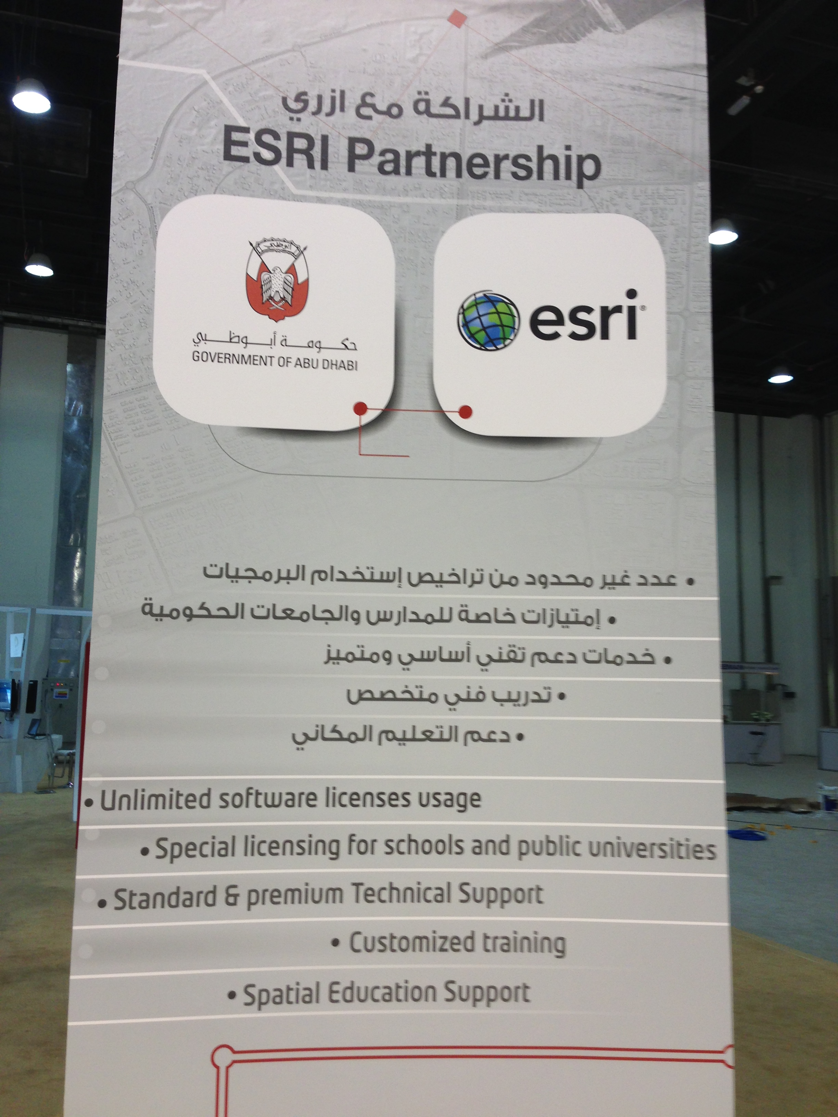
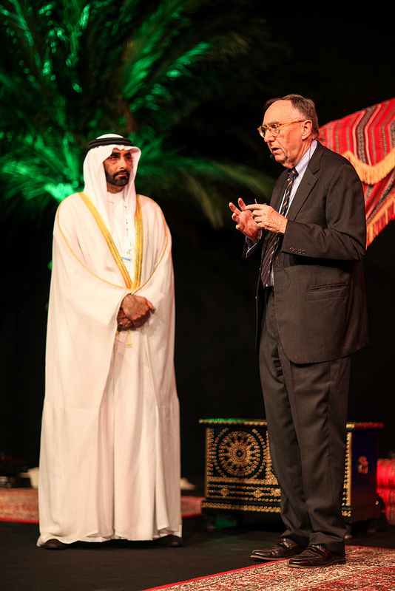
Notes:
One of our pioneering education collaborations, is with the Abu Dhabi government, which is in the process of modernization using GIS. This includes the use of GIS at schools and universities, and so Esri has been training Abu Dhabi teachers about the value of Spatial Thinking and about the use of GIS in science and mathematics clases.

Slide 41
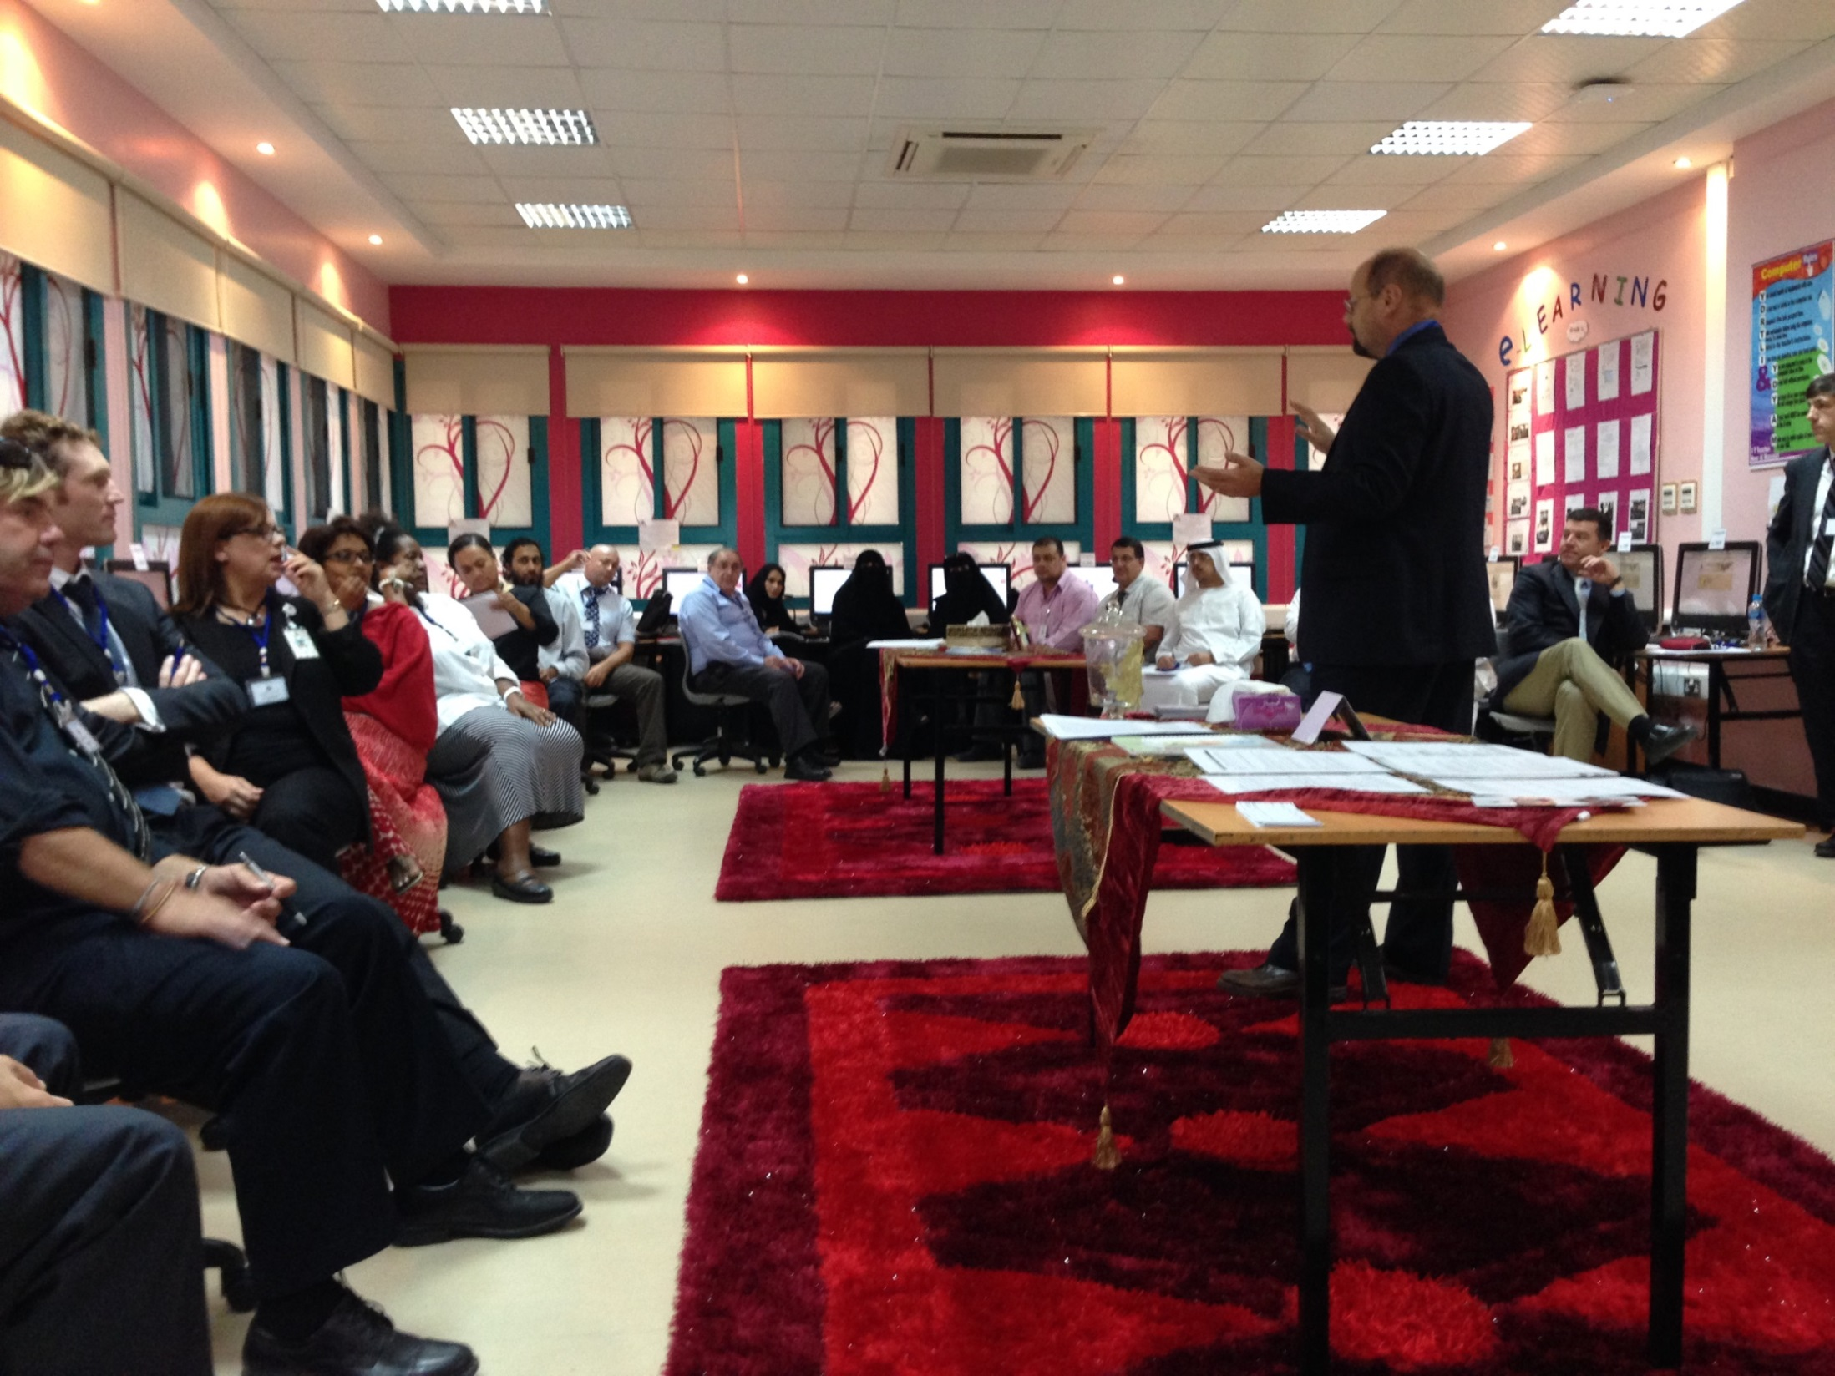
Notes:
Esri visited and trained more than 100 secondary school teachers of science and mathematics, to use ArcGIS Online to teach their classes!

Slide 42
Notes:
Teachers learned how to bring their students outside and collect data about their environment.

Slide 43
Notes:
Middle school students (around 13 years old) are now taking GIS into the field, to collect data about their environment (in this case the mangrove areas), and then when back in the classroom they analyze their data and answer environmental questions. The Abu Dhabi schools also like that these GIS projects are teaching their students about how to work in groups, be more analytical, and become future problem-solvers.

Slide 45
Notes:
Then back in the classroom they studied their own data in relation to other data layers in the geoportal. These GIS exercises are now being used in 6th grade classrooms in Abu Dhabi, with students who are 12 years old. GIS is becoming THE tool for teaching Science, Technology, Engineering and Math (STEM).

Slide 46
https://www.esri.com/about/newsroom/arcnews/abu-dhabis-education-council-finds-new-applications-for-gis/

Slide 47
Story Maps

Slide 48
www.sdg.org Open SDG Data Hub(s)

Slide 49
Tree Inventories/Tours

Slide 50
Women’s Rights
https://urbanobservatory.maps.arcgis.com/apps/Cascade/index.html?appid=dcaf1c22437e45b3acea2bdaf1999521

Slide 51
Stories about the Planet and its Champions
https://storymaps.arcgis.com/collections/0c89e00d504f429bb0a8dd7f6838ec56
https://storymaps.arcgis.com/collections/0c89e00d504f429bb0a8dd7f6838ec56

Slide 52
Summary
Greater Availability: Software and Data
Esri is providing Curated Data and Apps to Support Work on SDGs
Includes Online Learning Resources
Mobile GIS Apps allow us to Collect our own SDG-related Data
Classrooms can go from Talking about to Analyzing SDG data.
Don’t just read about it. Act.

Slide 53
Thanks for Your Attention mgould@esri.com

